Slide 1


Zhejiang Xunmai Electronics Co.,Ltd
浙江讯迈电子有限公司

Slide 2
  PRODUCT
  CATALOG
New Product Collection For 2025

Slide 3
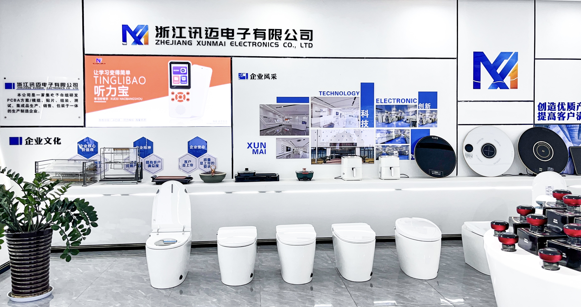
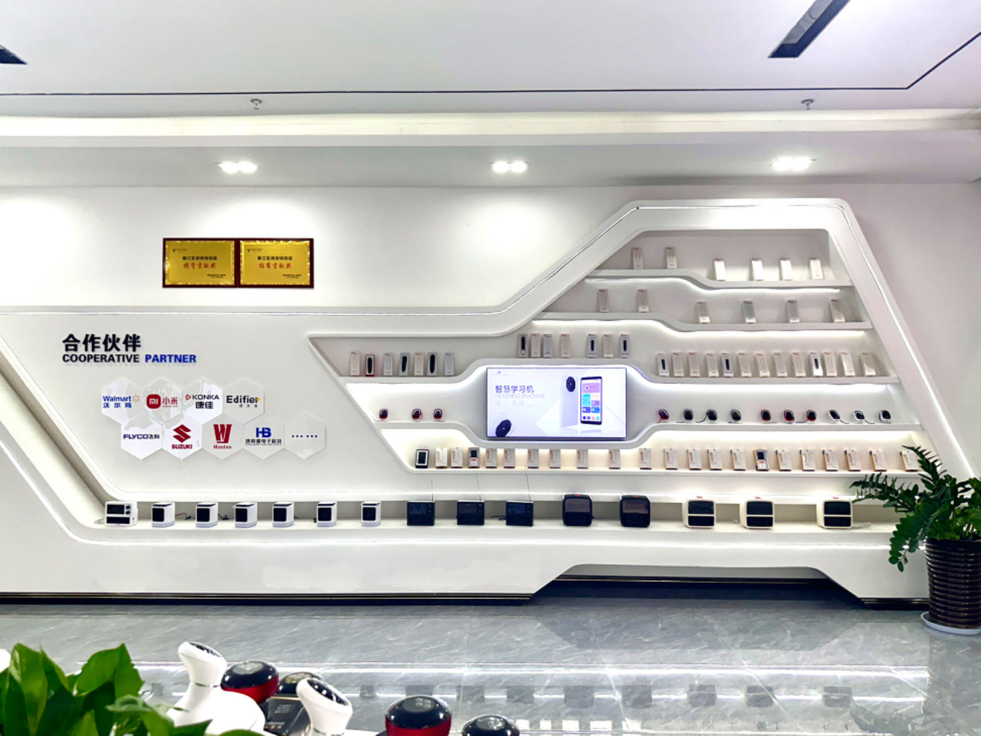
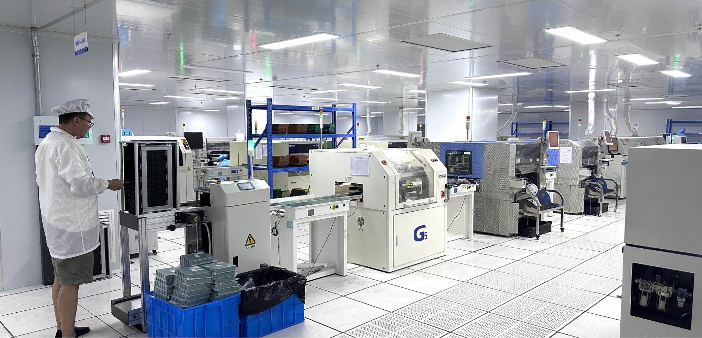
ABOUT US
Zhejiang Xunmai Electric Co., Ltd. is an innovative home appliance supplier,located in Quzhou, Zhejiang. Our product range covers hair dryers, Air fryer, hair curler etc. We have a mature technical team, a professional supply chain management system, and a complete and scientiﬁc quality control system. Based on stable product quality and diﬀerentiated innovation, we always catch the latest trends in the industry, striving to optimize product production and maximize customer beneﬁts.
Our products have CE, CB, KC, ETL, ROHS and other certiﬁcations, worry-free for global access.We have established long-term business relationships with customers in North America, Europe, Asia and other regions. After years of precipitation, we have not only accumulated extensive knowledge in domestic market dynamics and technological innovation, but also have rich experience in world-class appliances internationally. We are sincerely hoping to work hand in hand with you to create prosperity!

Slide 4





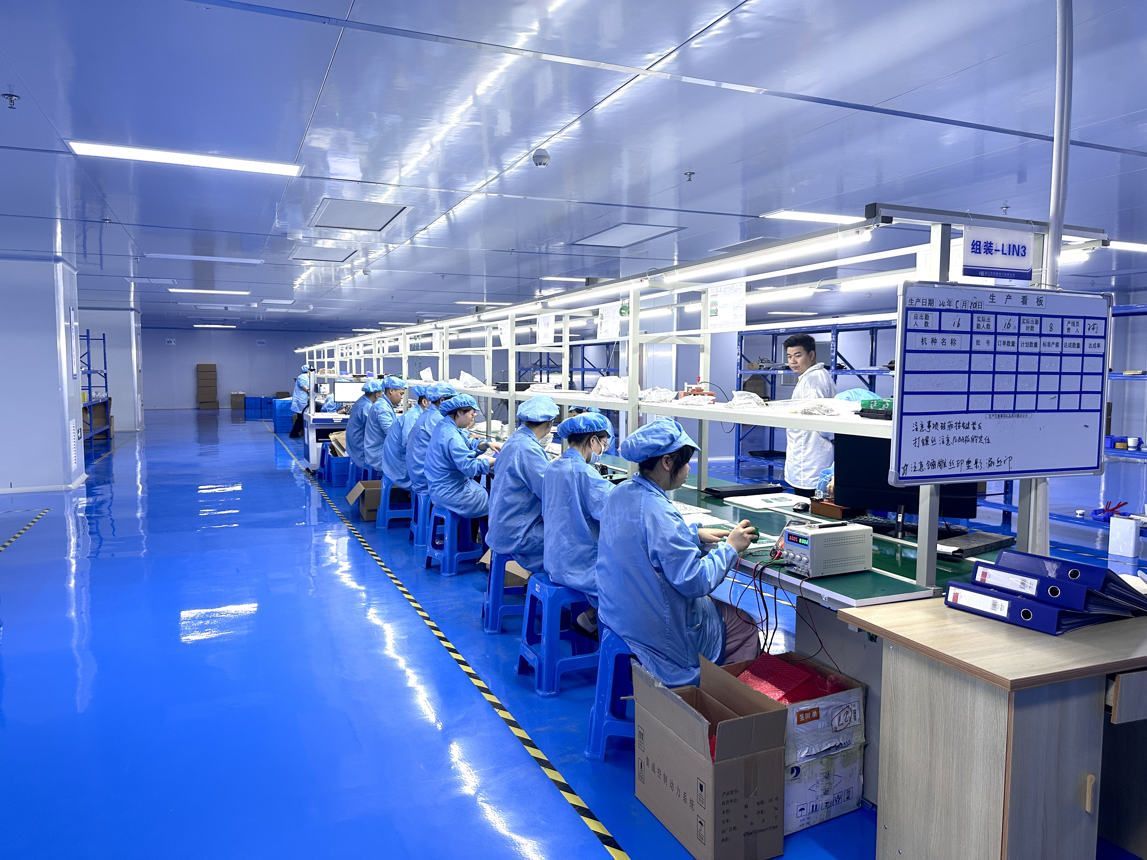
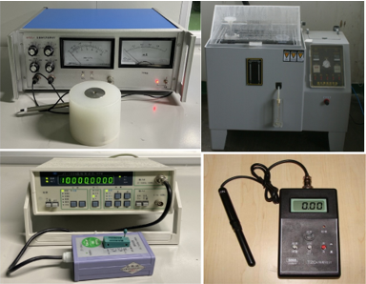
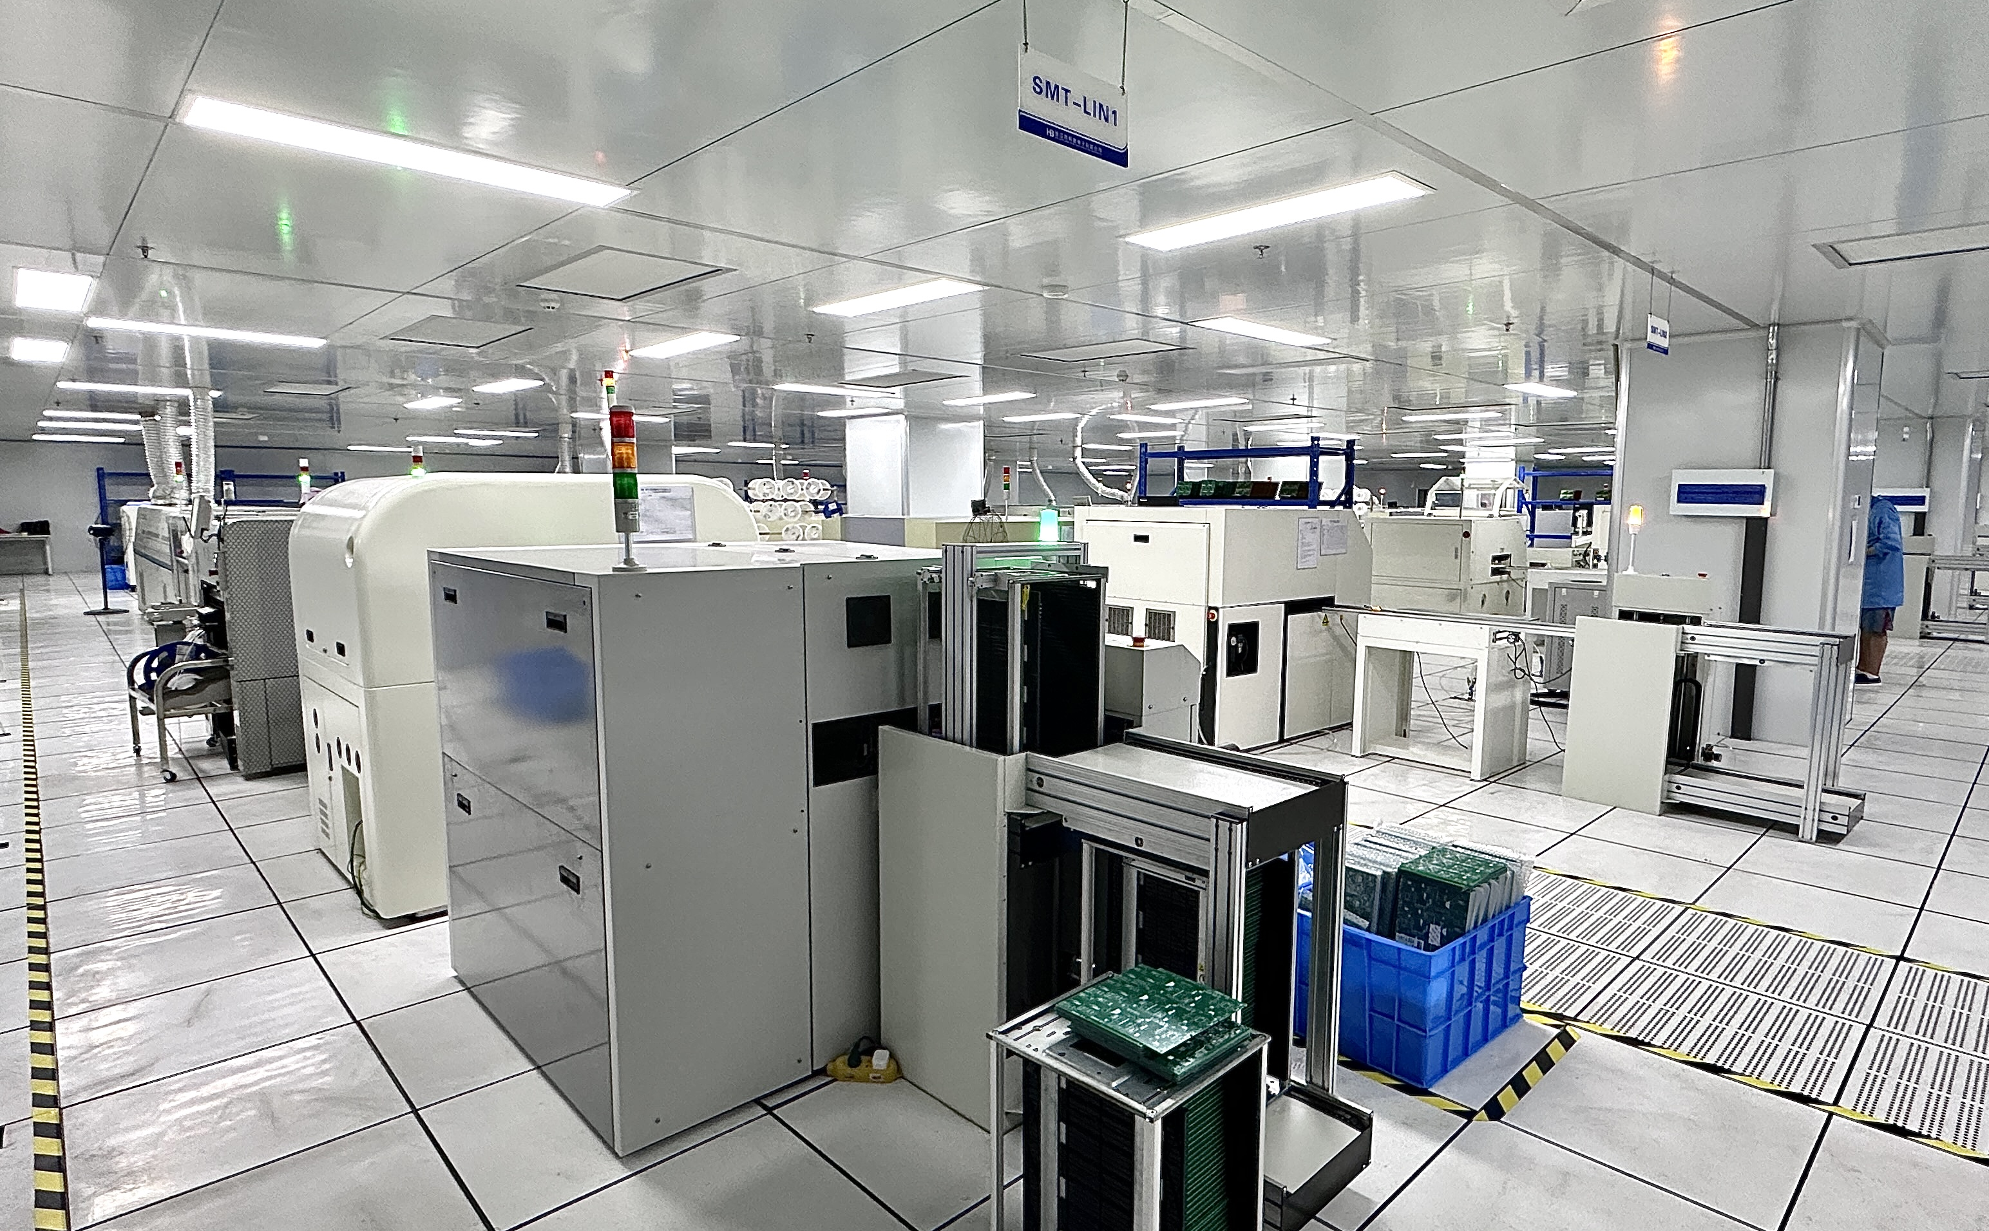
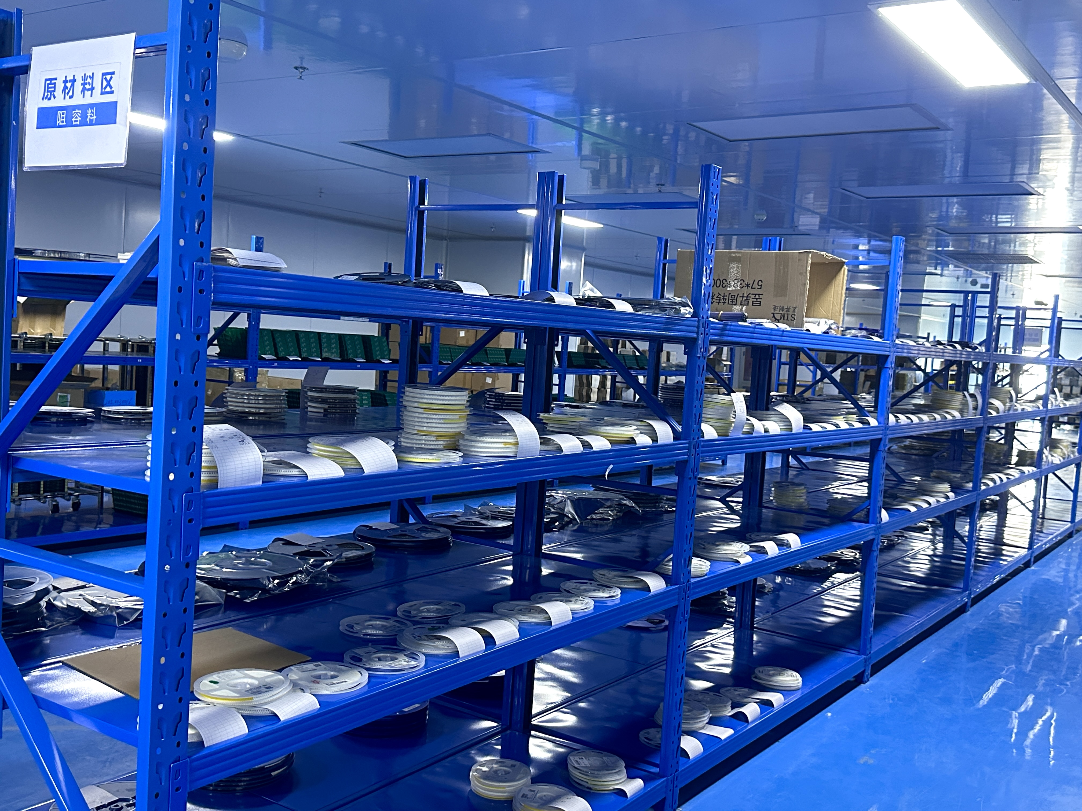
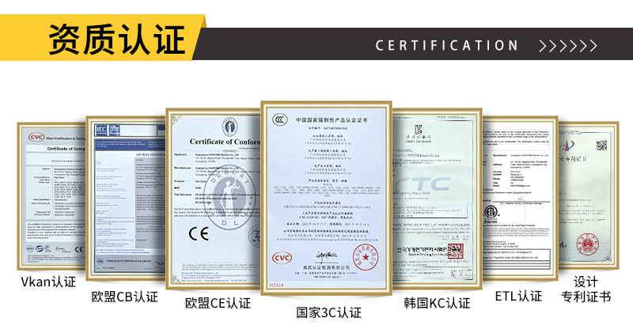
Professional Certification
Korea
Certiﬁcation
Certiﬁcation Bodies'
Scheme
European
Certiﬁed Enterprise
China Compulsory
Certiﬁcation
China lso9001 Quality
Assurance System
Customization
Our company has strong design team and R&D team, which improves and innovates product performance,
structure, and shape according to customer's requirements, and provides product drawings or samples for
development and production.
Cost
We have our own molding, injection and assembling workshop, to provide our customers with high-quality
products at excellent cost performance.
Quantity
The company has passed lSO19001 quality management system, lSO24001 environmental management system and lSO45001 occupational health management system certiﬁcation.We have our own professional laboratory
with various function testing instruments and equipments. Our professional testers have rich work experience to ensure product quality.

Slide 5
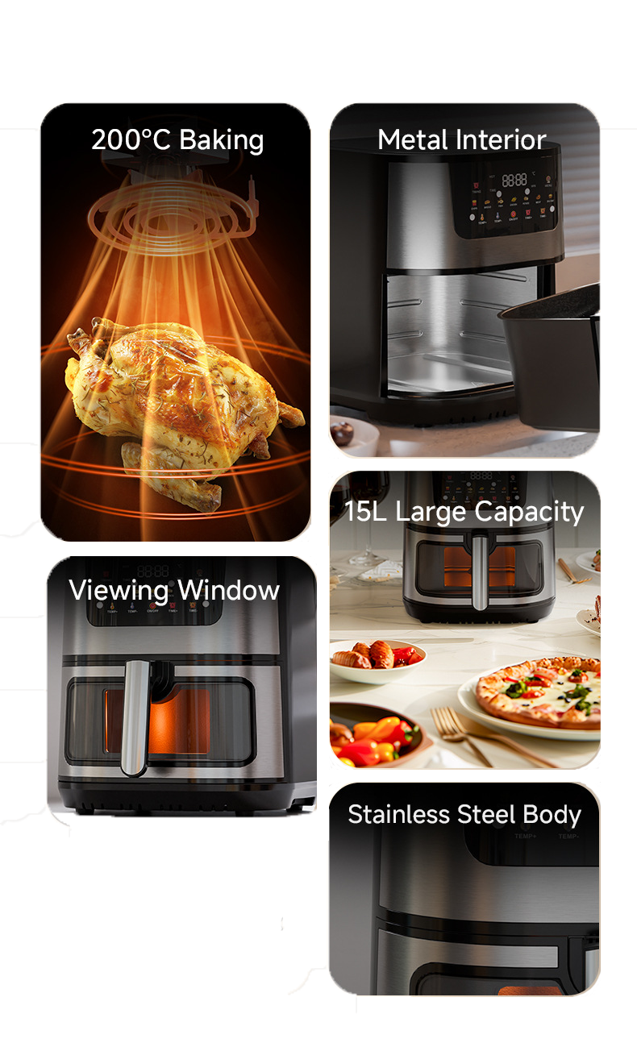
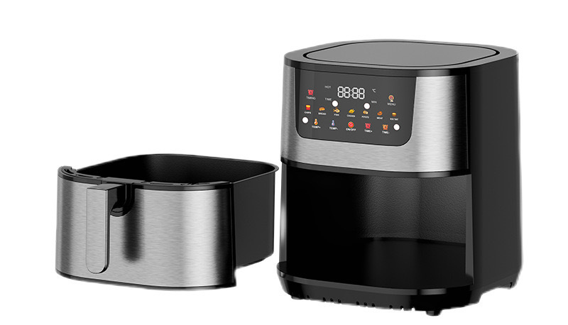
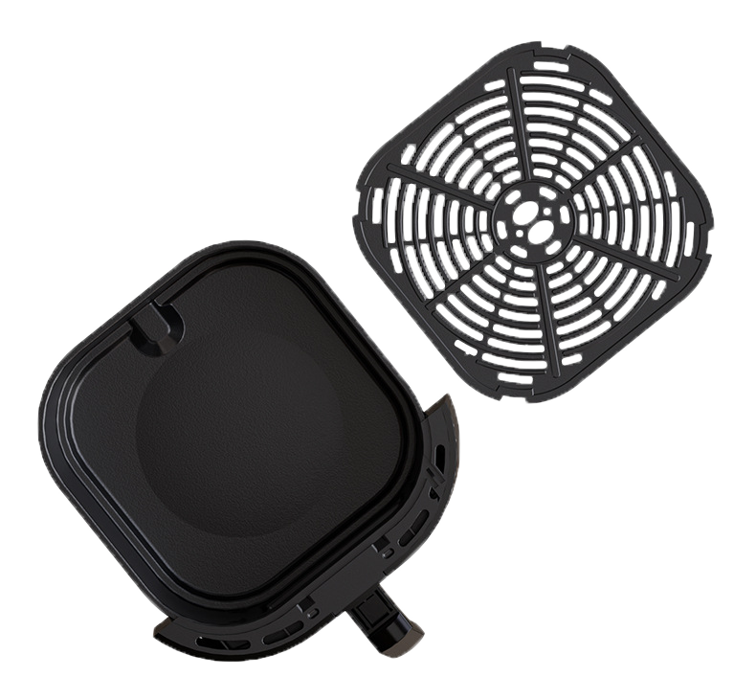





Air Fryer
AF-1501 LARGE-CAPACITY
15L AIR FRYER
·
360° high-speed heating and three-dimensional hot air circulation technology.
15L large capacity to meet the whole family's needs.
Seven major menus with one-click selection, easily make delicious dishes.
Pot removal power-off protection and memory function for continuous frying after reinstalling.
·
·
·
2000w
80~200℃
Rated power
Temperature adjustment
34.5*31*30cm
1H
Product Size
Set Time
15L
Capacity

Slide 6
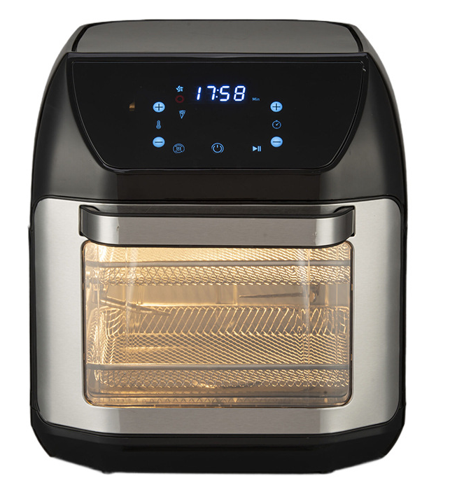
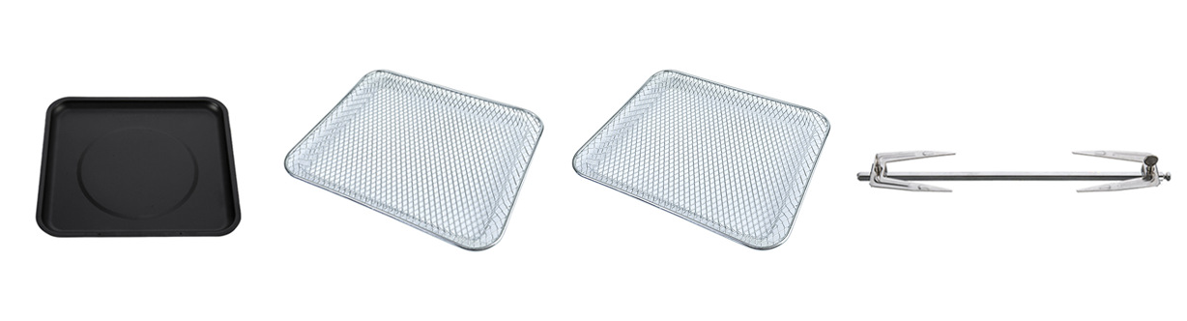
Air Fryer
AF-1201 12L MULTIFUNCTIONAL AIR FRYER
·
1700w
·
360° high - speed heating, 3D hot air circulation.
12L large capacity with double - layer fry basket, meets family needs.
Colorful touchscreen, one - touch operation.
Visual window for food status check.
Pot - removal power - off protection, memory for continuous frying.
Rated power
·
30*32*36cm
·
Product Size
12L
Capacity
80~200℃
Temperature adjustment
Oil drip tray/
Roasting pan
Air fryer
basket
Air fryer
basket
Air fryer
basket
30min
Set Time

Slide 7
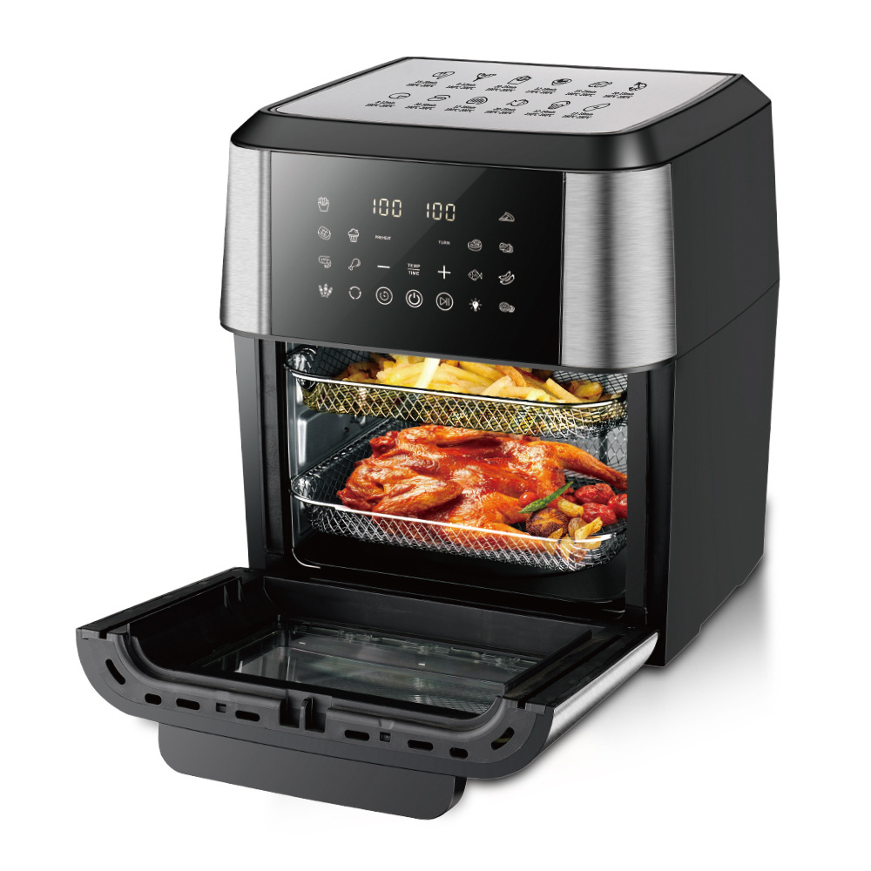
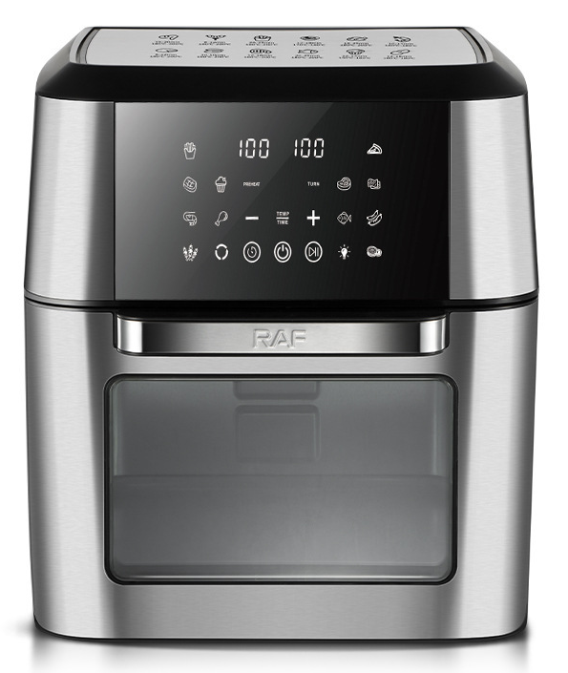
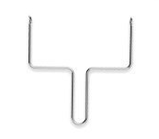
Air Fryer
AF-1202 12L MULTIFUNCTIONAL AIR FRYER
·
·
360° high - speed heating, 3D hot air circulation.
12L large capacity with double - layer fry basket, meets family needs.
Colorful touchscreen, one - touch operation.
Visual window for food status check.
Pot - removal power - off protection, memory for continuous frying.
1750w
Rated power
·
·
36*28*27cm
·
Product Size
12L
Capacity
80~200℃
Temperature adjustment
30min
Set Time
Rotisserie fork handle
Oil drip tray/
Roasting pan
Air fryer
basket
Air fryer
basket
Air fryer
basket

Slide 8
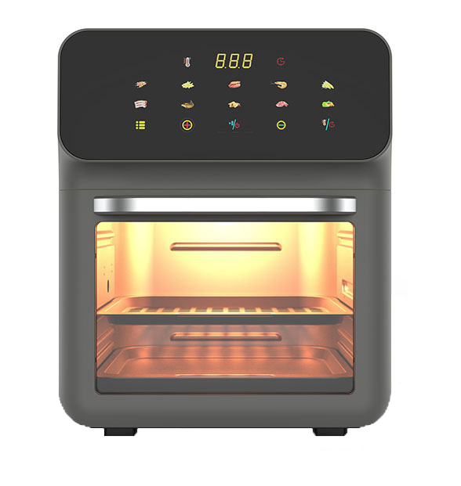

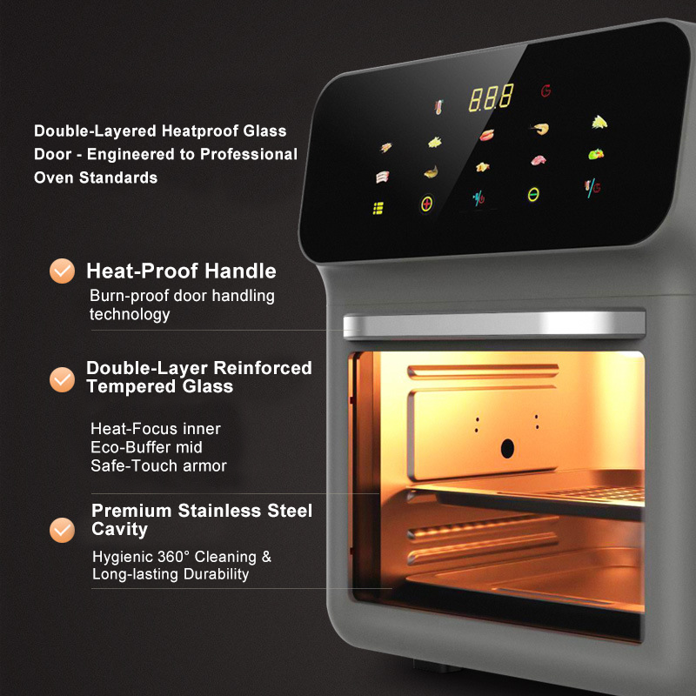
Air Fryer
AF-1001 10L AIR FRYER
·
·
360° high - speed heating, 3D hot air circulation.
10L large capacity with double - layer fry basket, meets family needs.
Colorful touchscreen, one - touch operation.
Visual window for food status check.
Pot - removal power - off protection, memory for continuous frying.
·
·
·
1750w
30min
Rated power
Set Time
10L
28.5*31.5*34.5cm
Capacity
Product Size
80~200℃
Temperature adjustment

Slide 9
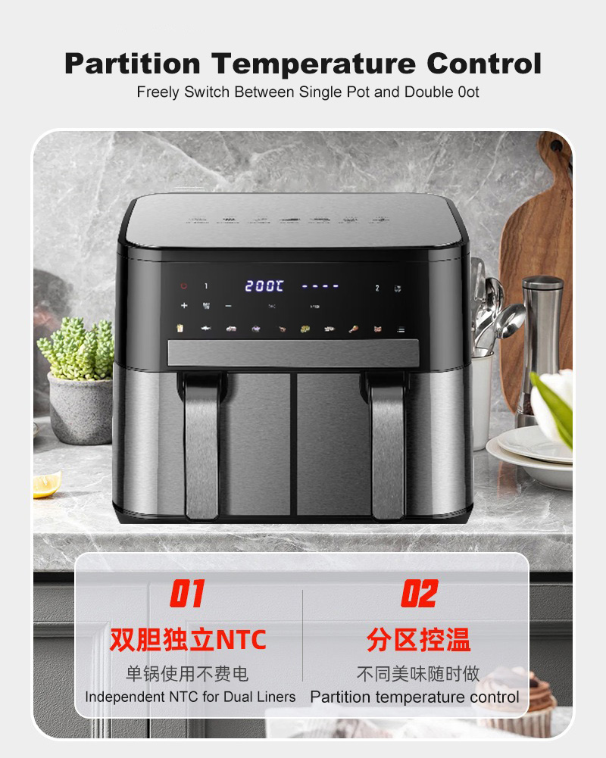
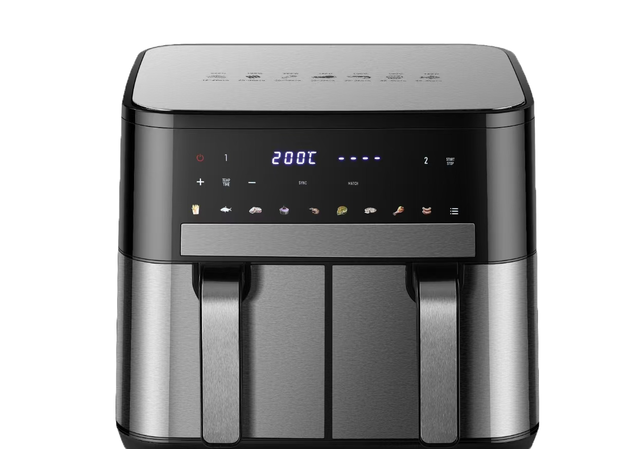
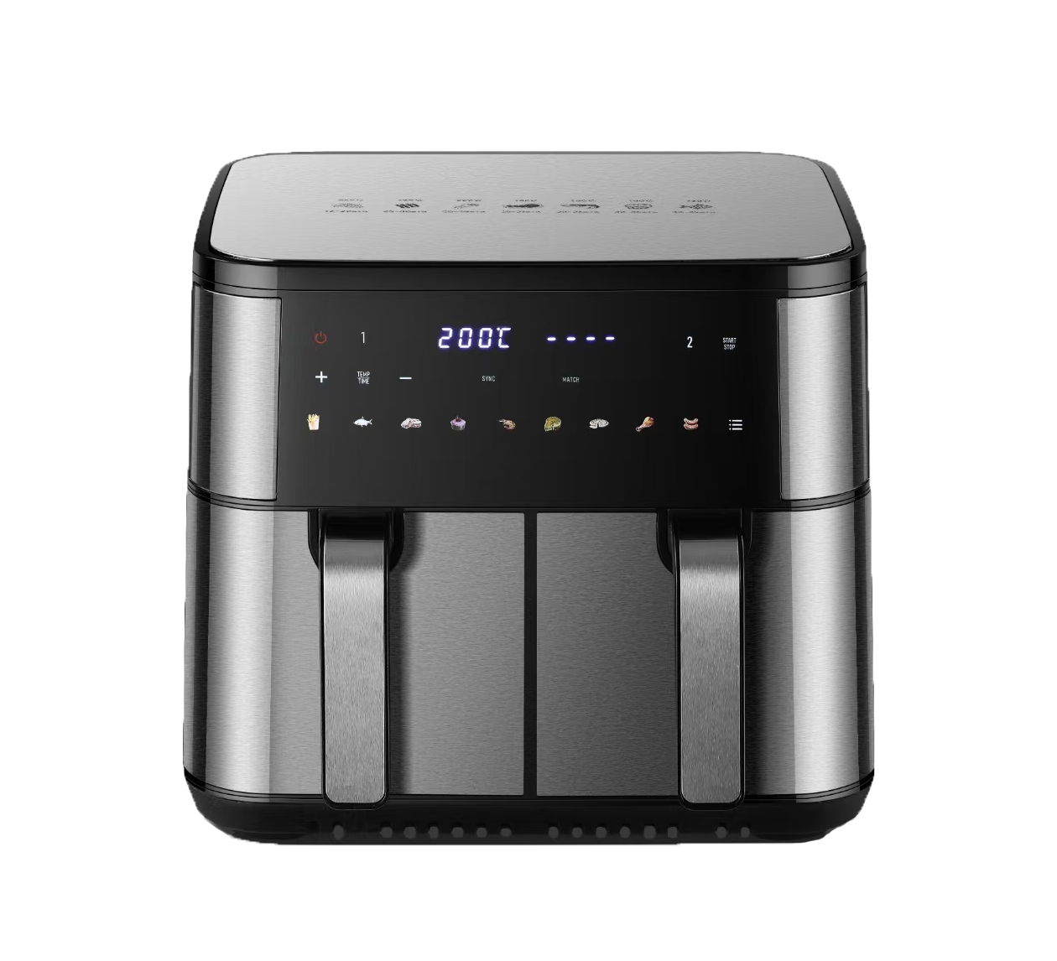
Air Fryer
AF-1002 DOUBLE-BARREL AIR FRYER
·
·
360° high - speed heating, 3D hot air circulation.
Double-barrel design enables simultaneous cooking of different delicacies.
Colorful touchscreen buttons offer instant enjoyment with just one touch.
With a large capacity of 5L + 5L, it meets the needs of the whole family.
Pot - removal power - off protection, memory for continuous frying.
·
2200w
Rated power
·
38*40.5*32cm
·
Product Size
80~200℃
Stainless Steel+Glass
Temperature adjustment
Stainless Steel
10L
Capacity
1H
Set Time

Slide 10
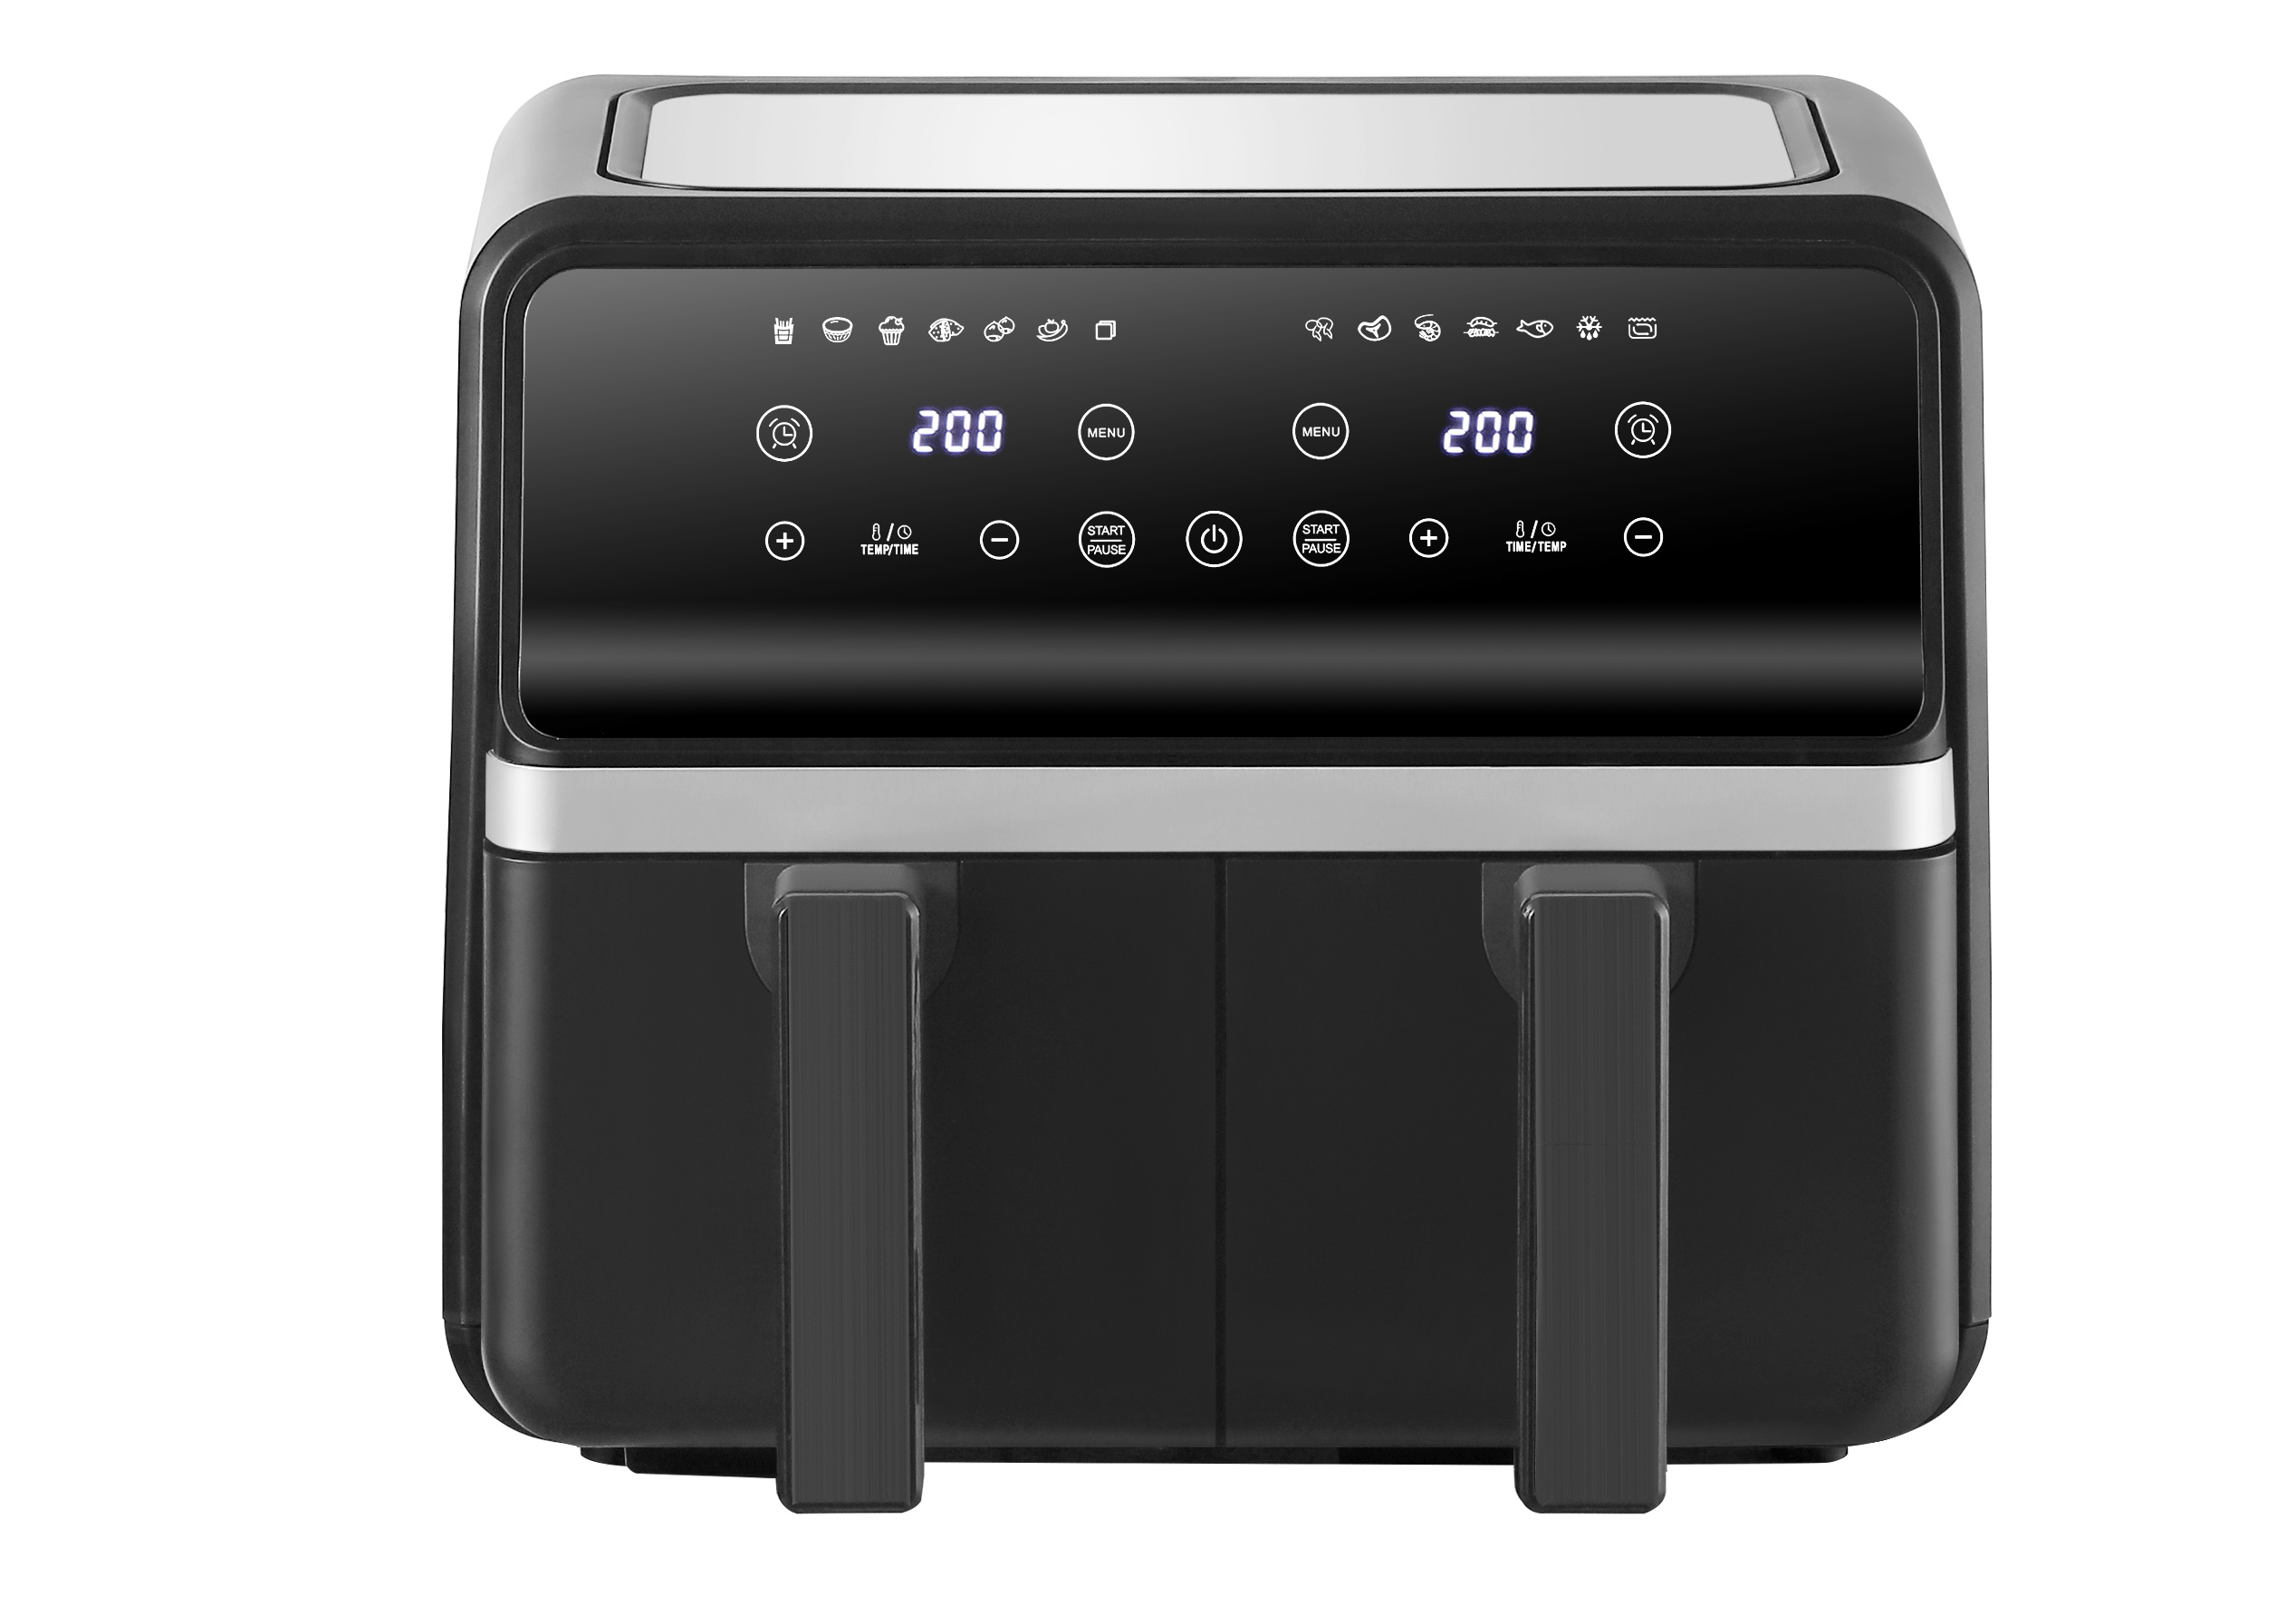
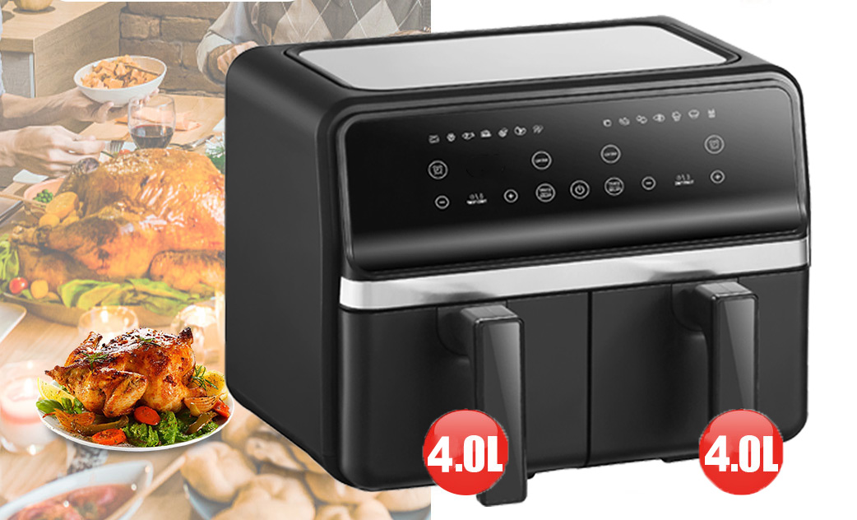
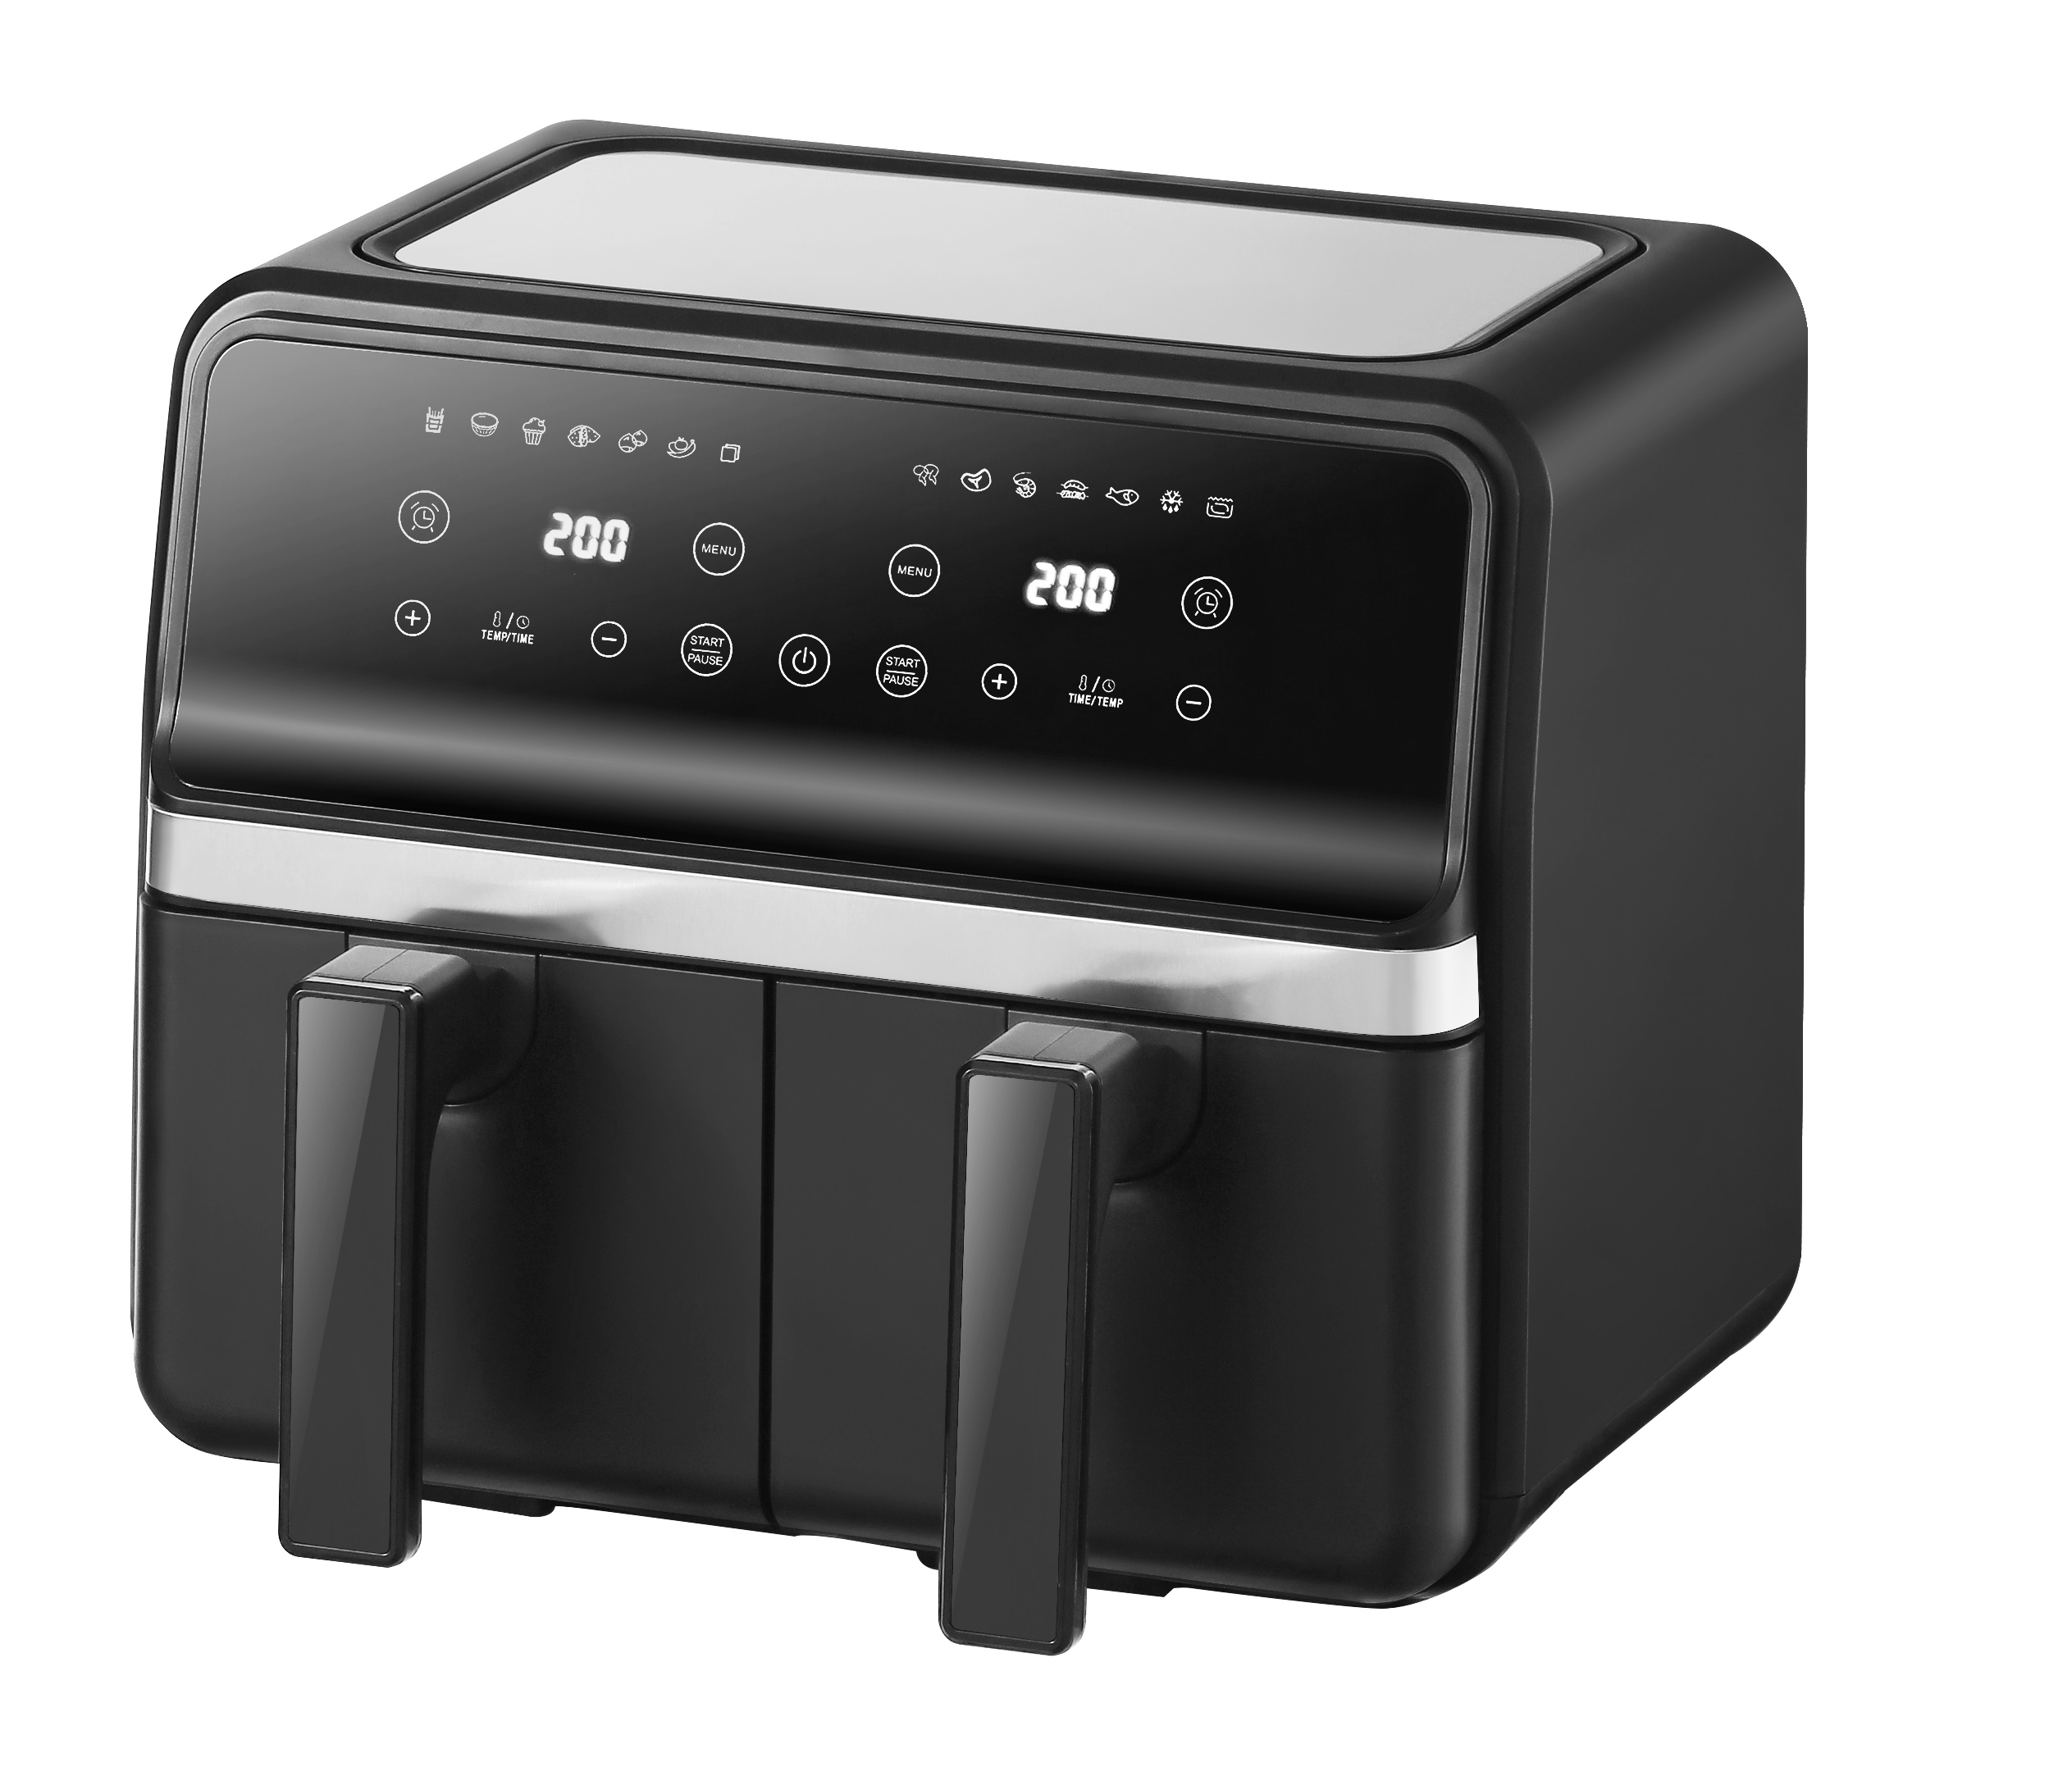
空气炸锅
Air Fryer
AF-0801 DOUBLE-BARREL AIR FRYER
·
·
360° high - speed heating, 3D hot air circulation.
Double-barrel design enables simultaneous cooking of different delicacies.
Colorful touchscreen buttons offer instant enjoyment with just one touch.
With a large capacity of 5L + 5L, it meets the needs of the whole family.
Pot - removal power - off protection, memory for continuous frying.
Invisible Type
2100w
·
Rated power
·
37.4x35x41cm
·
Product Size
80~200℃
Temperature adjustment
8L
Capacity
1H
Set Time

Slide 11
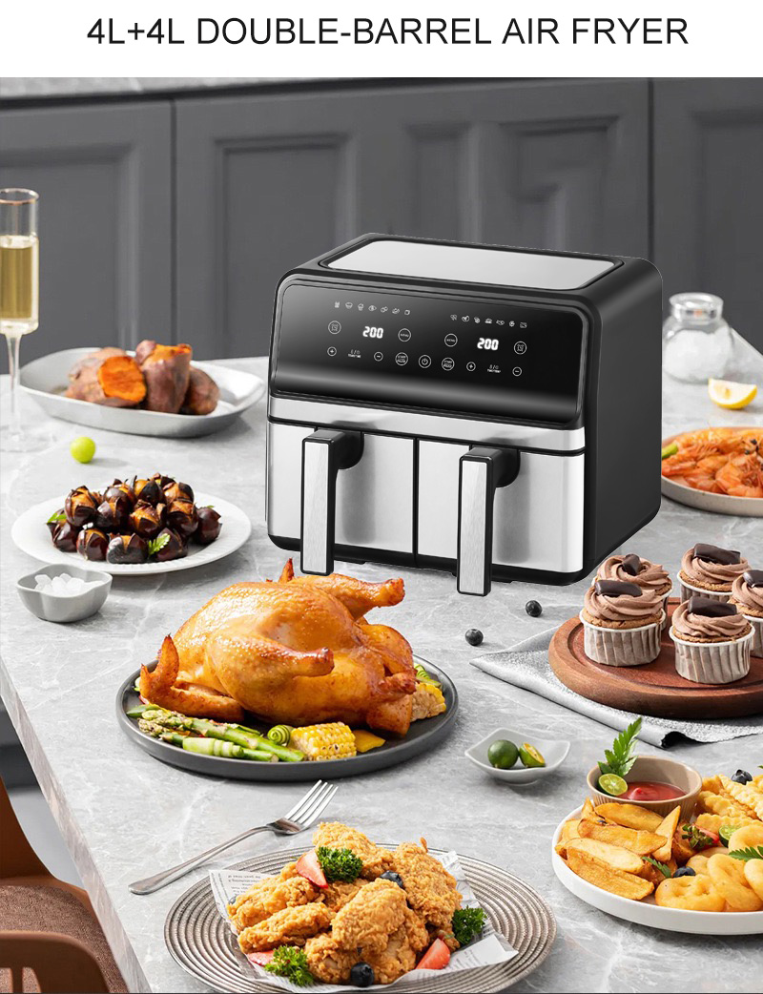
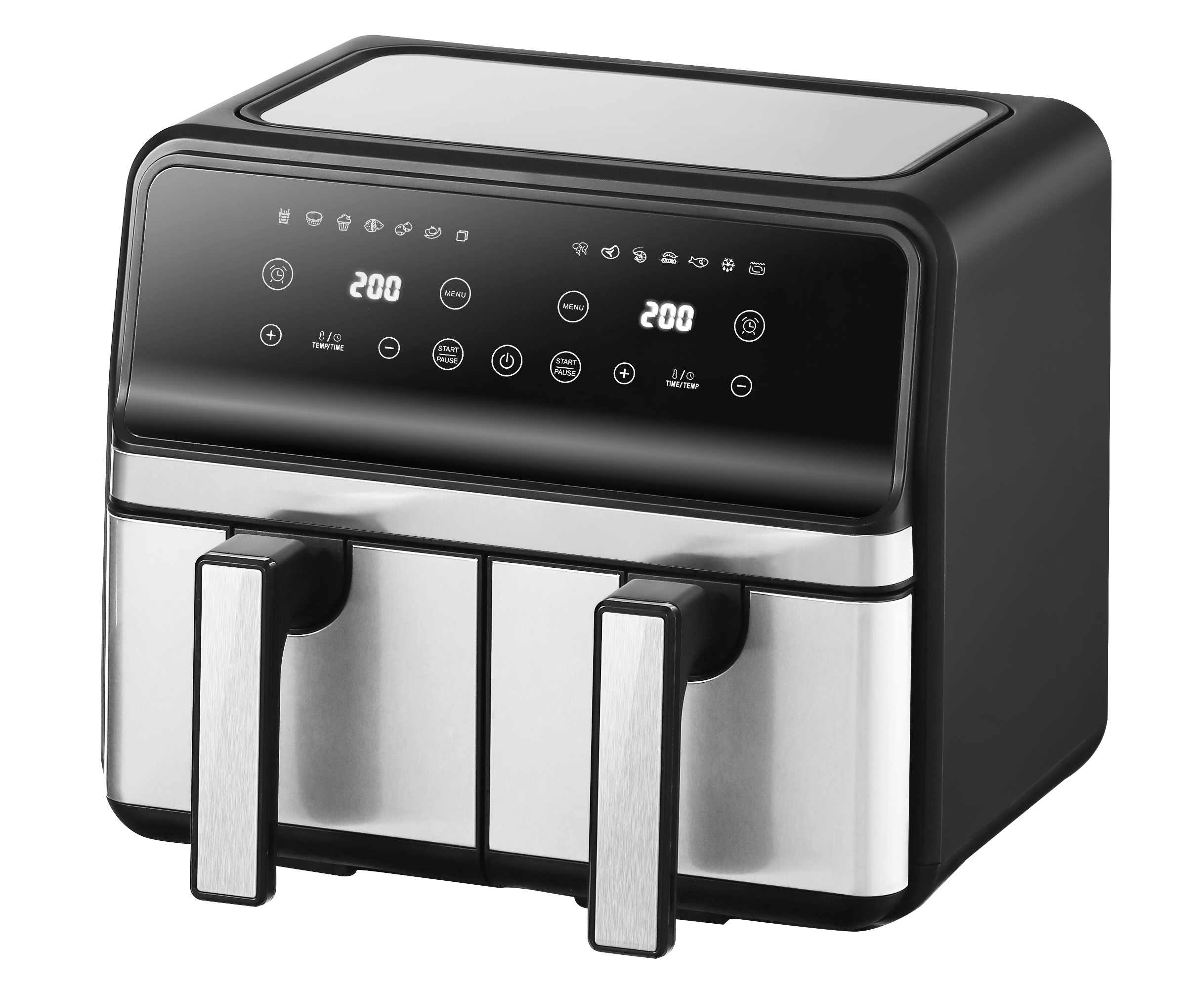
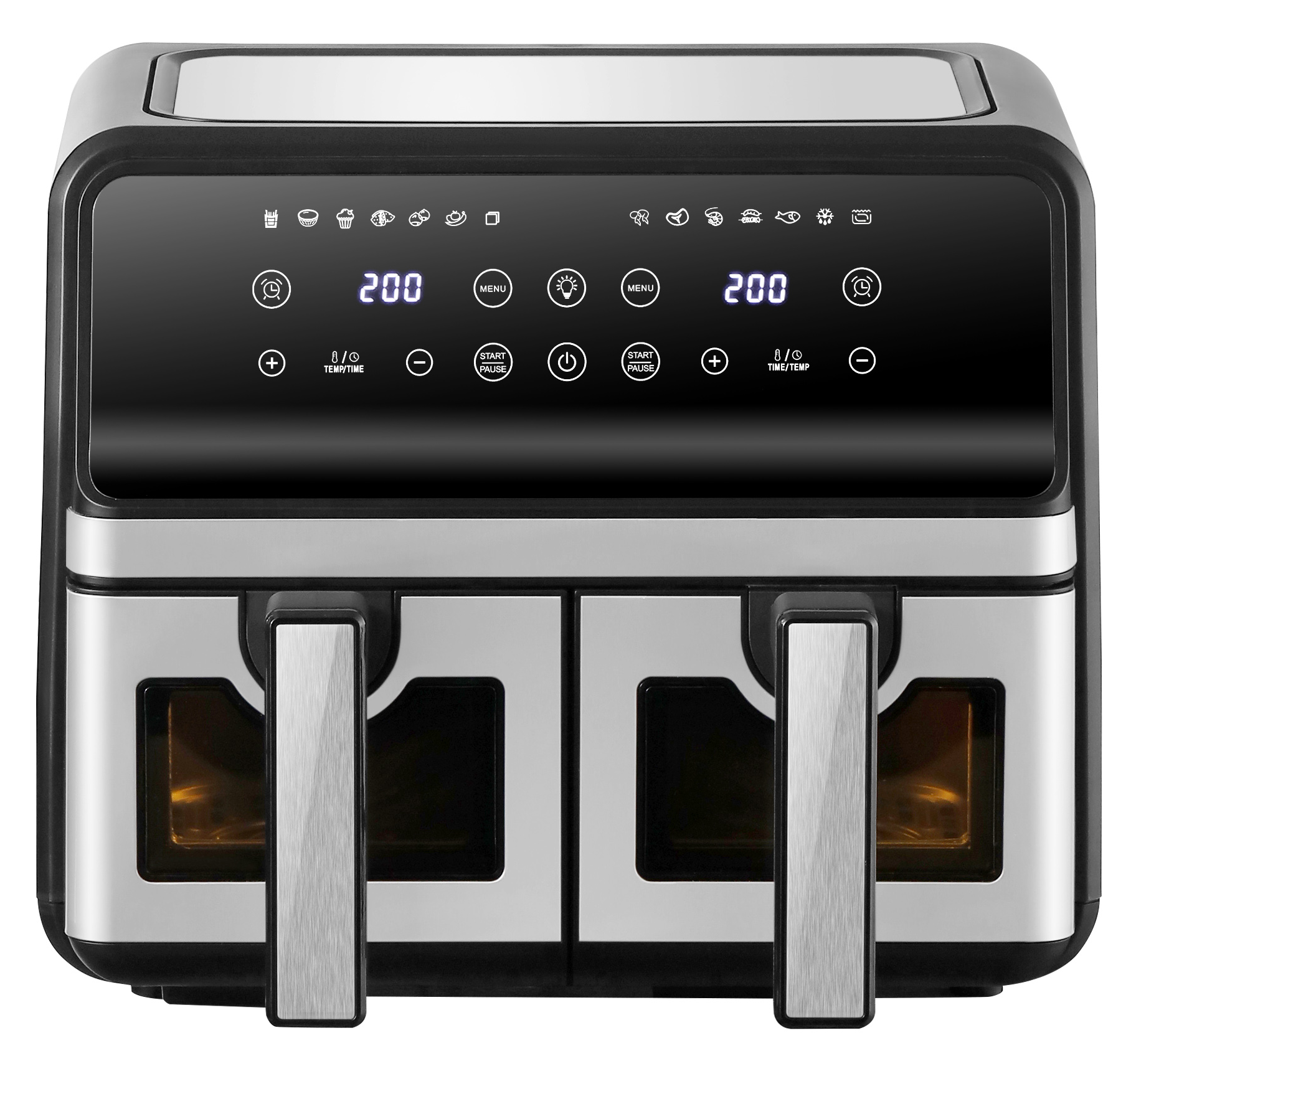
Air Fryer
AF-0802 DOUBLE-BARREL AIR FRYER
·
·
360° high - speed heating, 3D hot air circulation.
Double-barrel design enables simultaneous cooking of different delicacies.
Colorful touchscreen buttons offer instant enjoyment with just one touch.
With a large capacity of 5L + 5L, it meets the needs of the whole family.
Pot - removal power - off protection, memory for continuous frying.
·
2100w
Rated power
·
·
37.4x35x41cm
Product Size
80~200℃
Temperature adjustment
Invisible Type
Visible Type
8L
Capacity
1H
Set Time

Slide 12
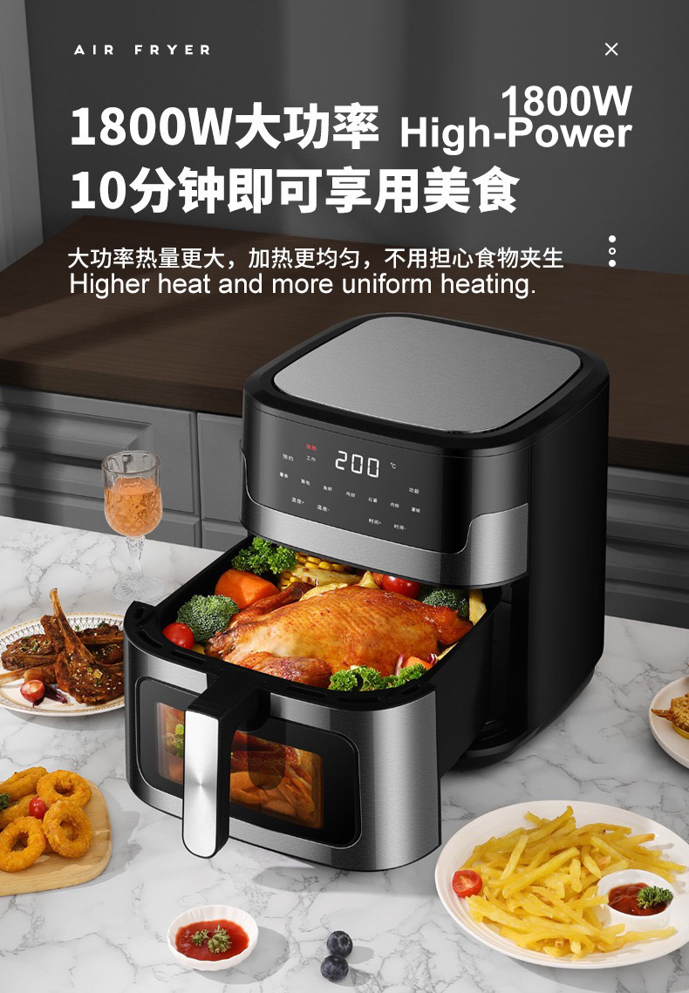
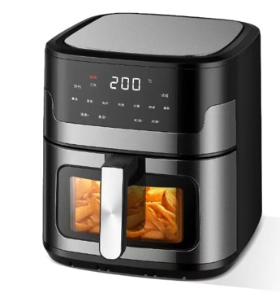
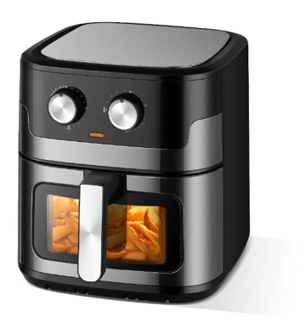
Air Fryer
AF-0803 8L AIR FRYER
·
·
360° high - speed heating, 3D hot air circulation.
8L large capacity, meets family needs.
Colorful touchscreen, Intelligent dual knobs for time and temperature control
Pot - removal power - off protection, memory for continuous frying.
·
1800w
Rated power
·
41.5*35.5*38.5cm
Product Size
Mechanical Model
8L
LCD model
Capacity
80~200℃
Temperature adjustment
1H
Set Time

Slide 13
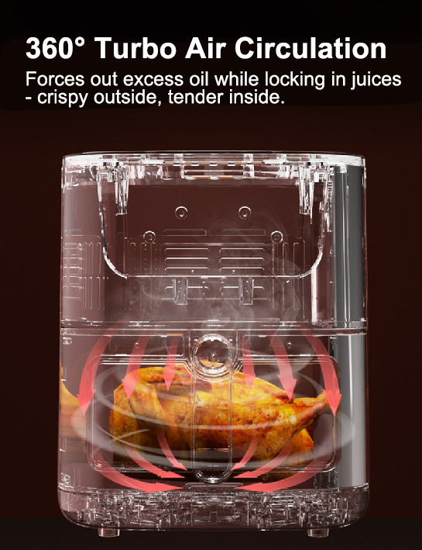
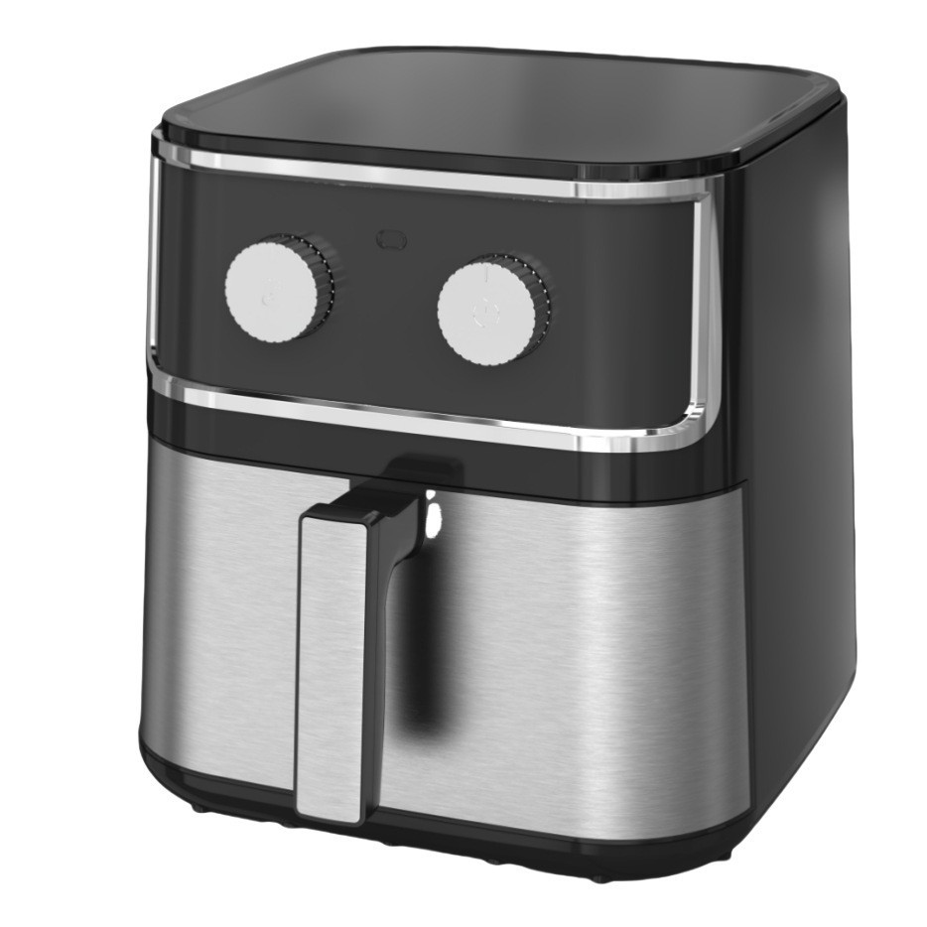
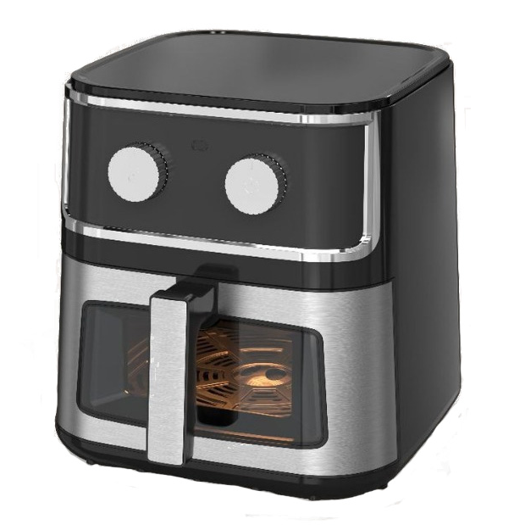
Air Fryer
AF-0805 8L MECHANICAL-STYLE AIR FRYER
·
·
360° high - speed heating, 3D hot air circulation.
8L large capacity, meets family needs.
Intelligent dual knobs for time and temperature control, cook as you wish.
Pot - removal power - off protection, memory for continuous frying.
1700w
·
Rated power
·
35*35*37cm
Product Size
Invisible Type
Visible Type
80~200℃
Temperature adjustment
8L
Capacity
1H
Set Time

Slide 14
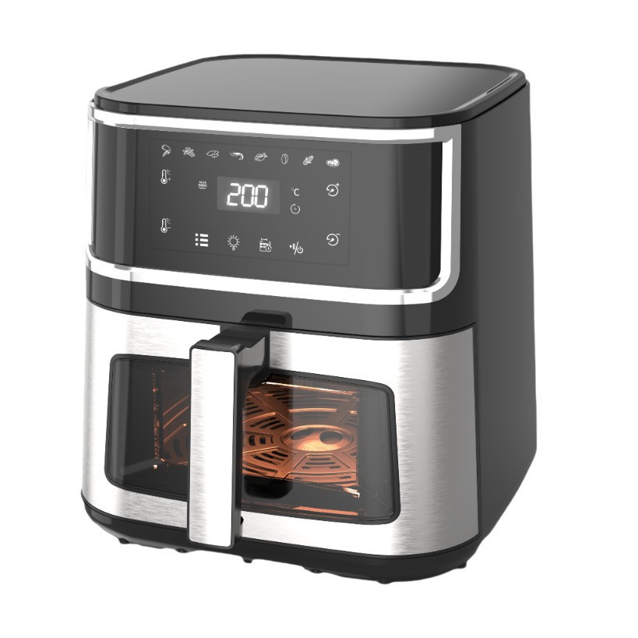
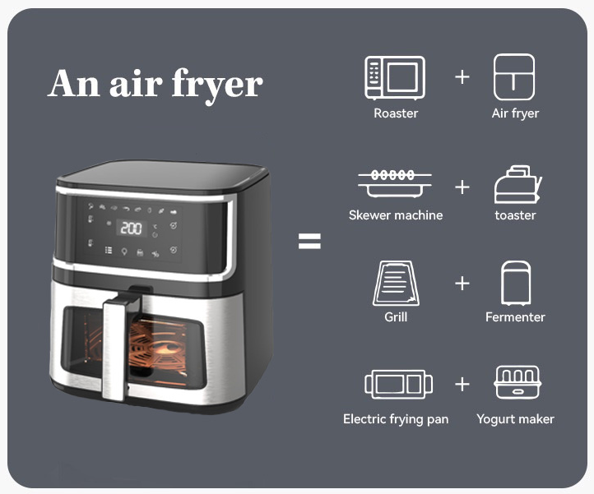
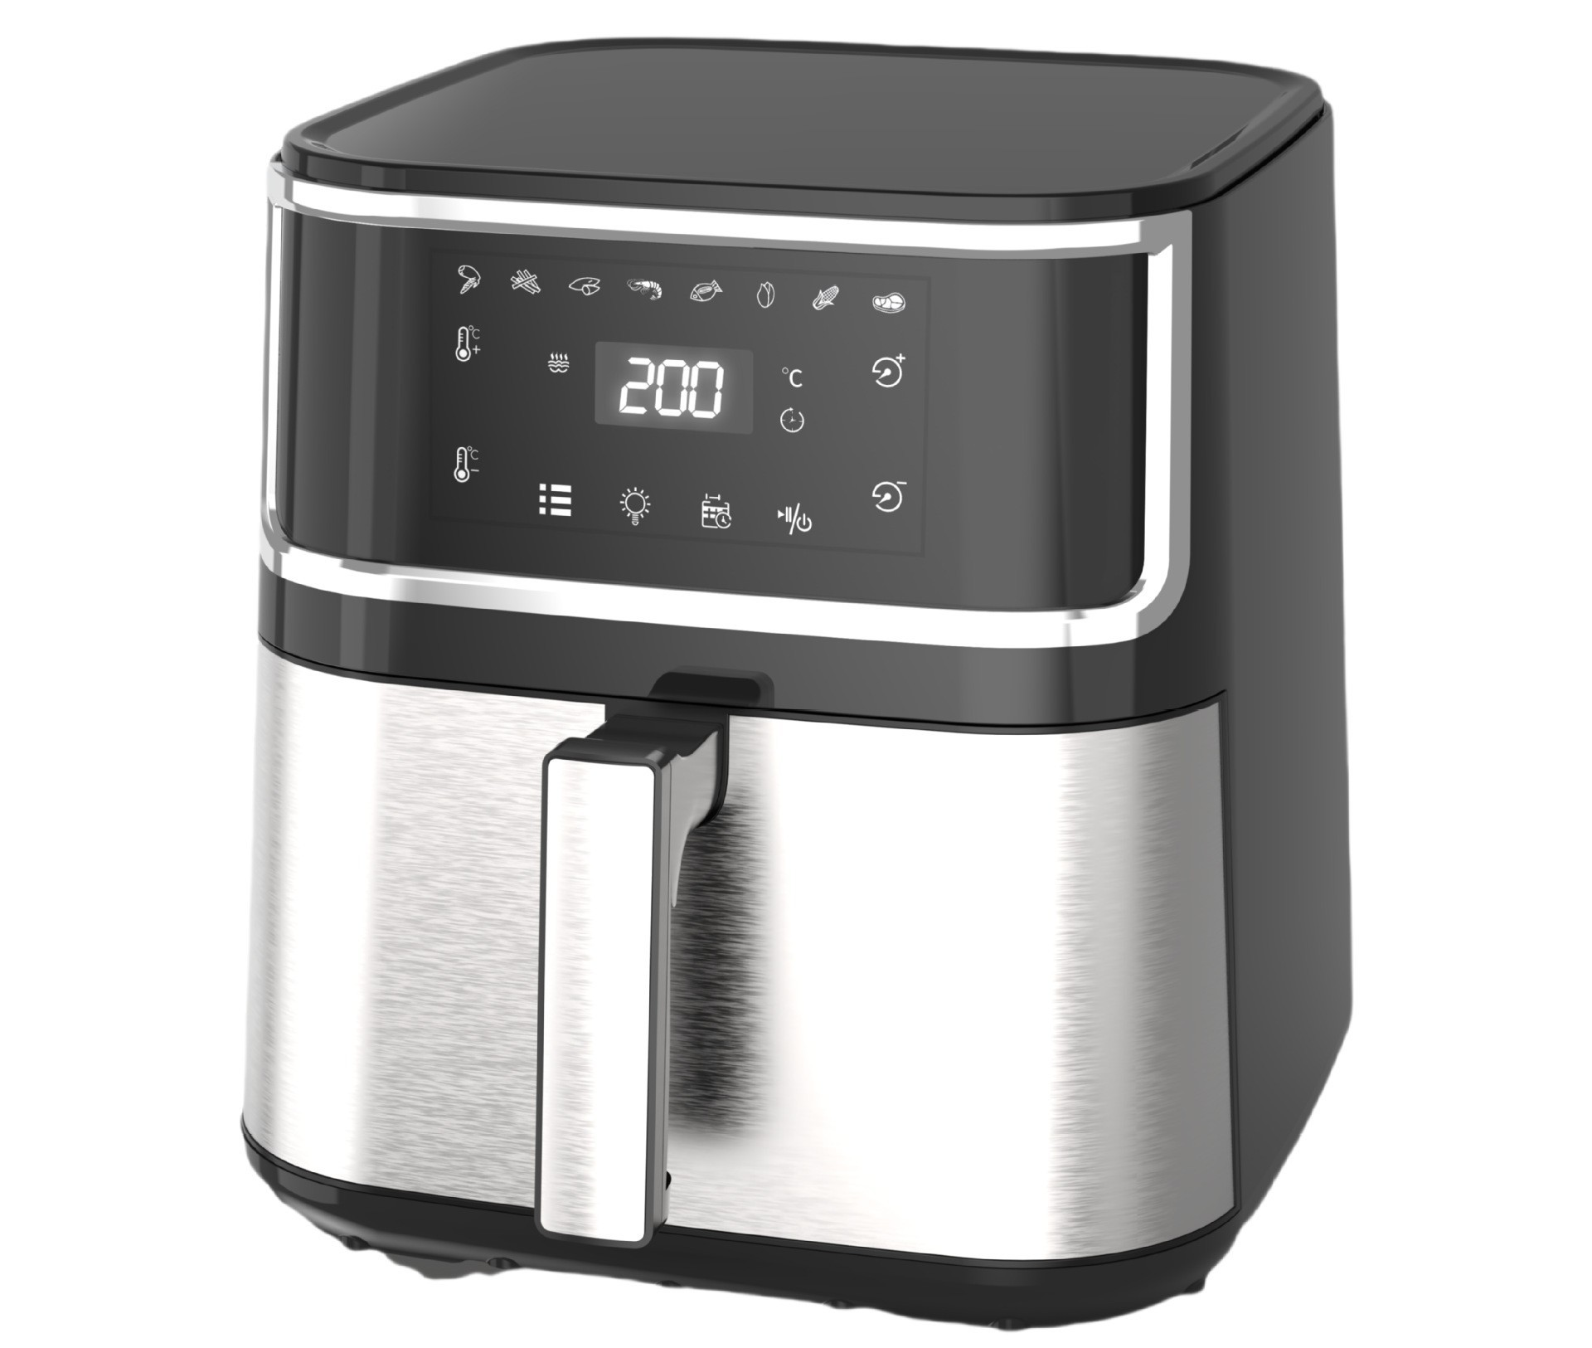
Air Fryer
AF-0806 8L AIR FRYER
Visible Type
·
·
360° high - speed heating, 3D hot air circulation.
8L large capacity, meets family needs.
Colorful touchscreen, one - touch operation.
Pot - removal power - off protection, memory for continuous frying.
·
1700w
·
Rated power
35*35*37cm
Product Size
80~200℃
Invisible Type
Temperature adjustment
8L
Capacity
1H
Set Time

Slide 15
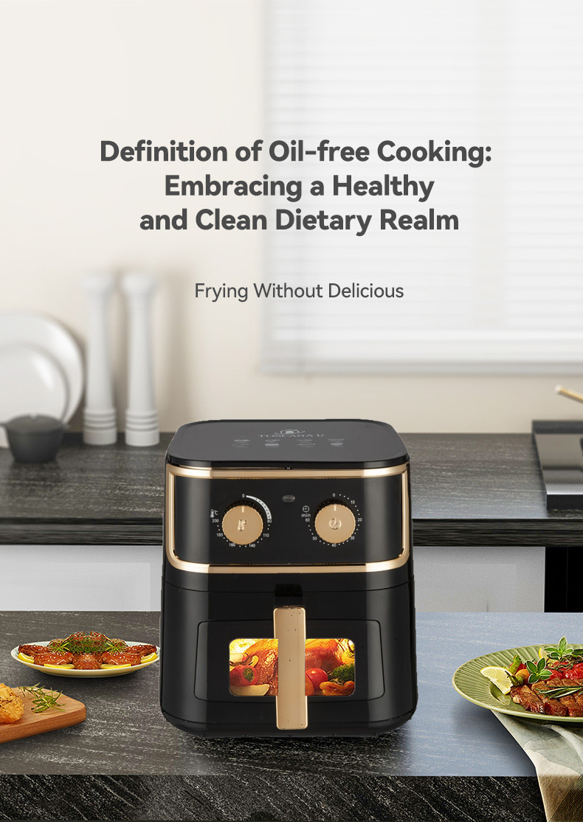
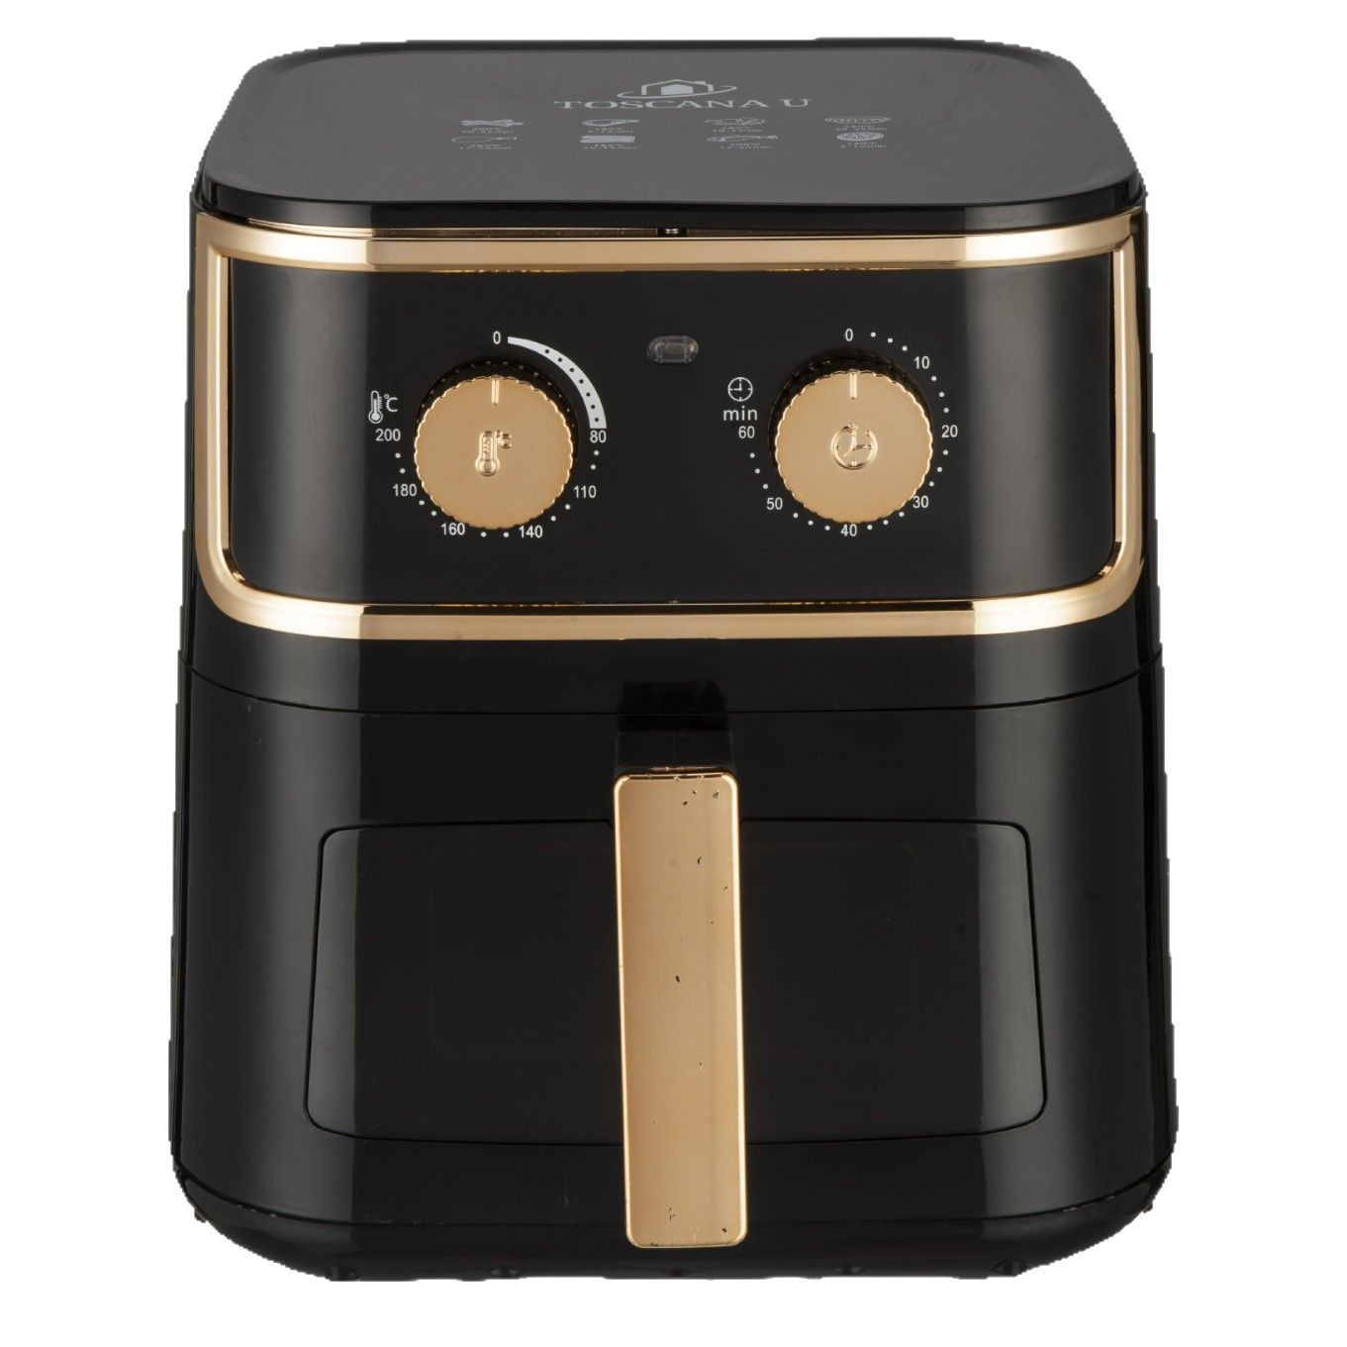
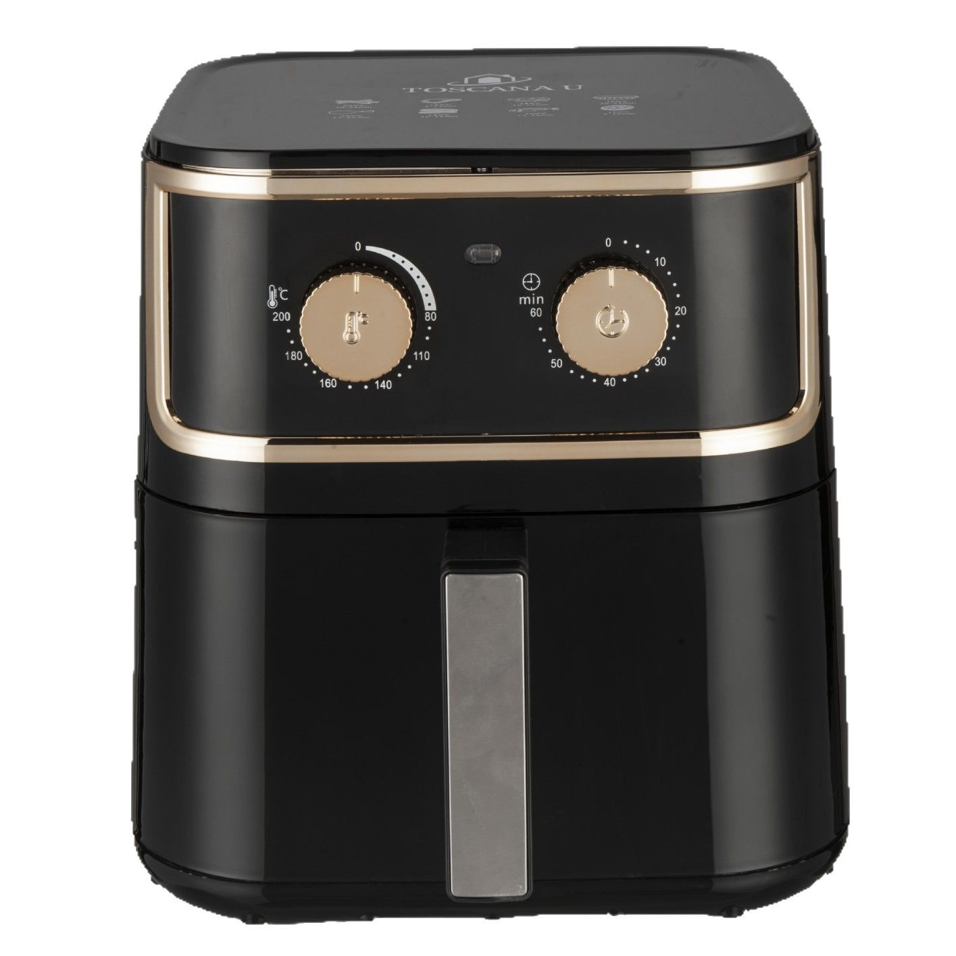
Air Fryer
AF-0807 8L AIR FRYER
Visible Type
Invisible Type
1700w
Rated power
35*35*37cm
Product Size
80~200℃
Temperature adjustment
·
·
360° high - speed heating, 3D hot air circulation.
8L large capacity, meets family needs.
Colorful touchscreen, one - touch operation.
Pot - removal power - off protection, memory for continuous frying.
8L
·
Capacity
·
1H
Set Time

Slide 16
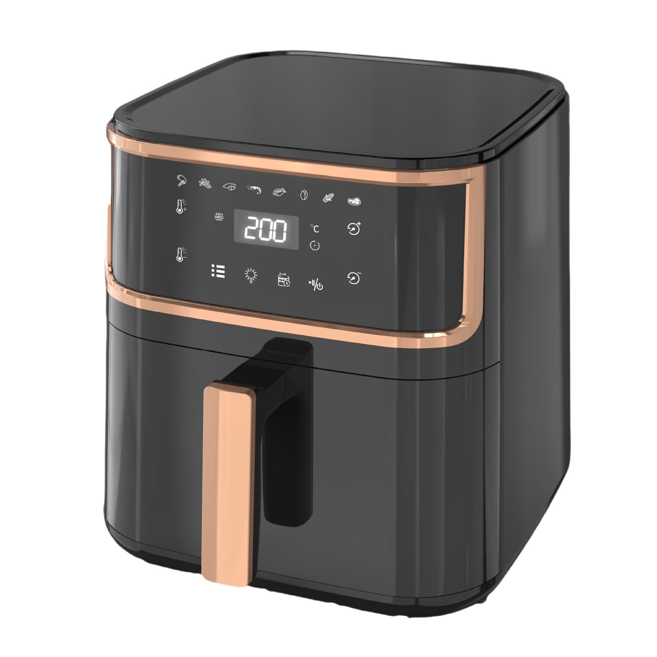
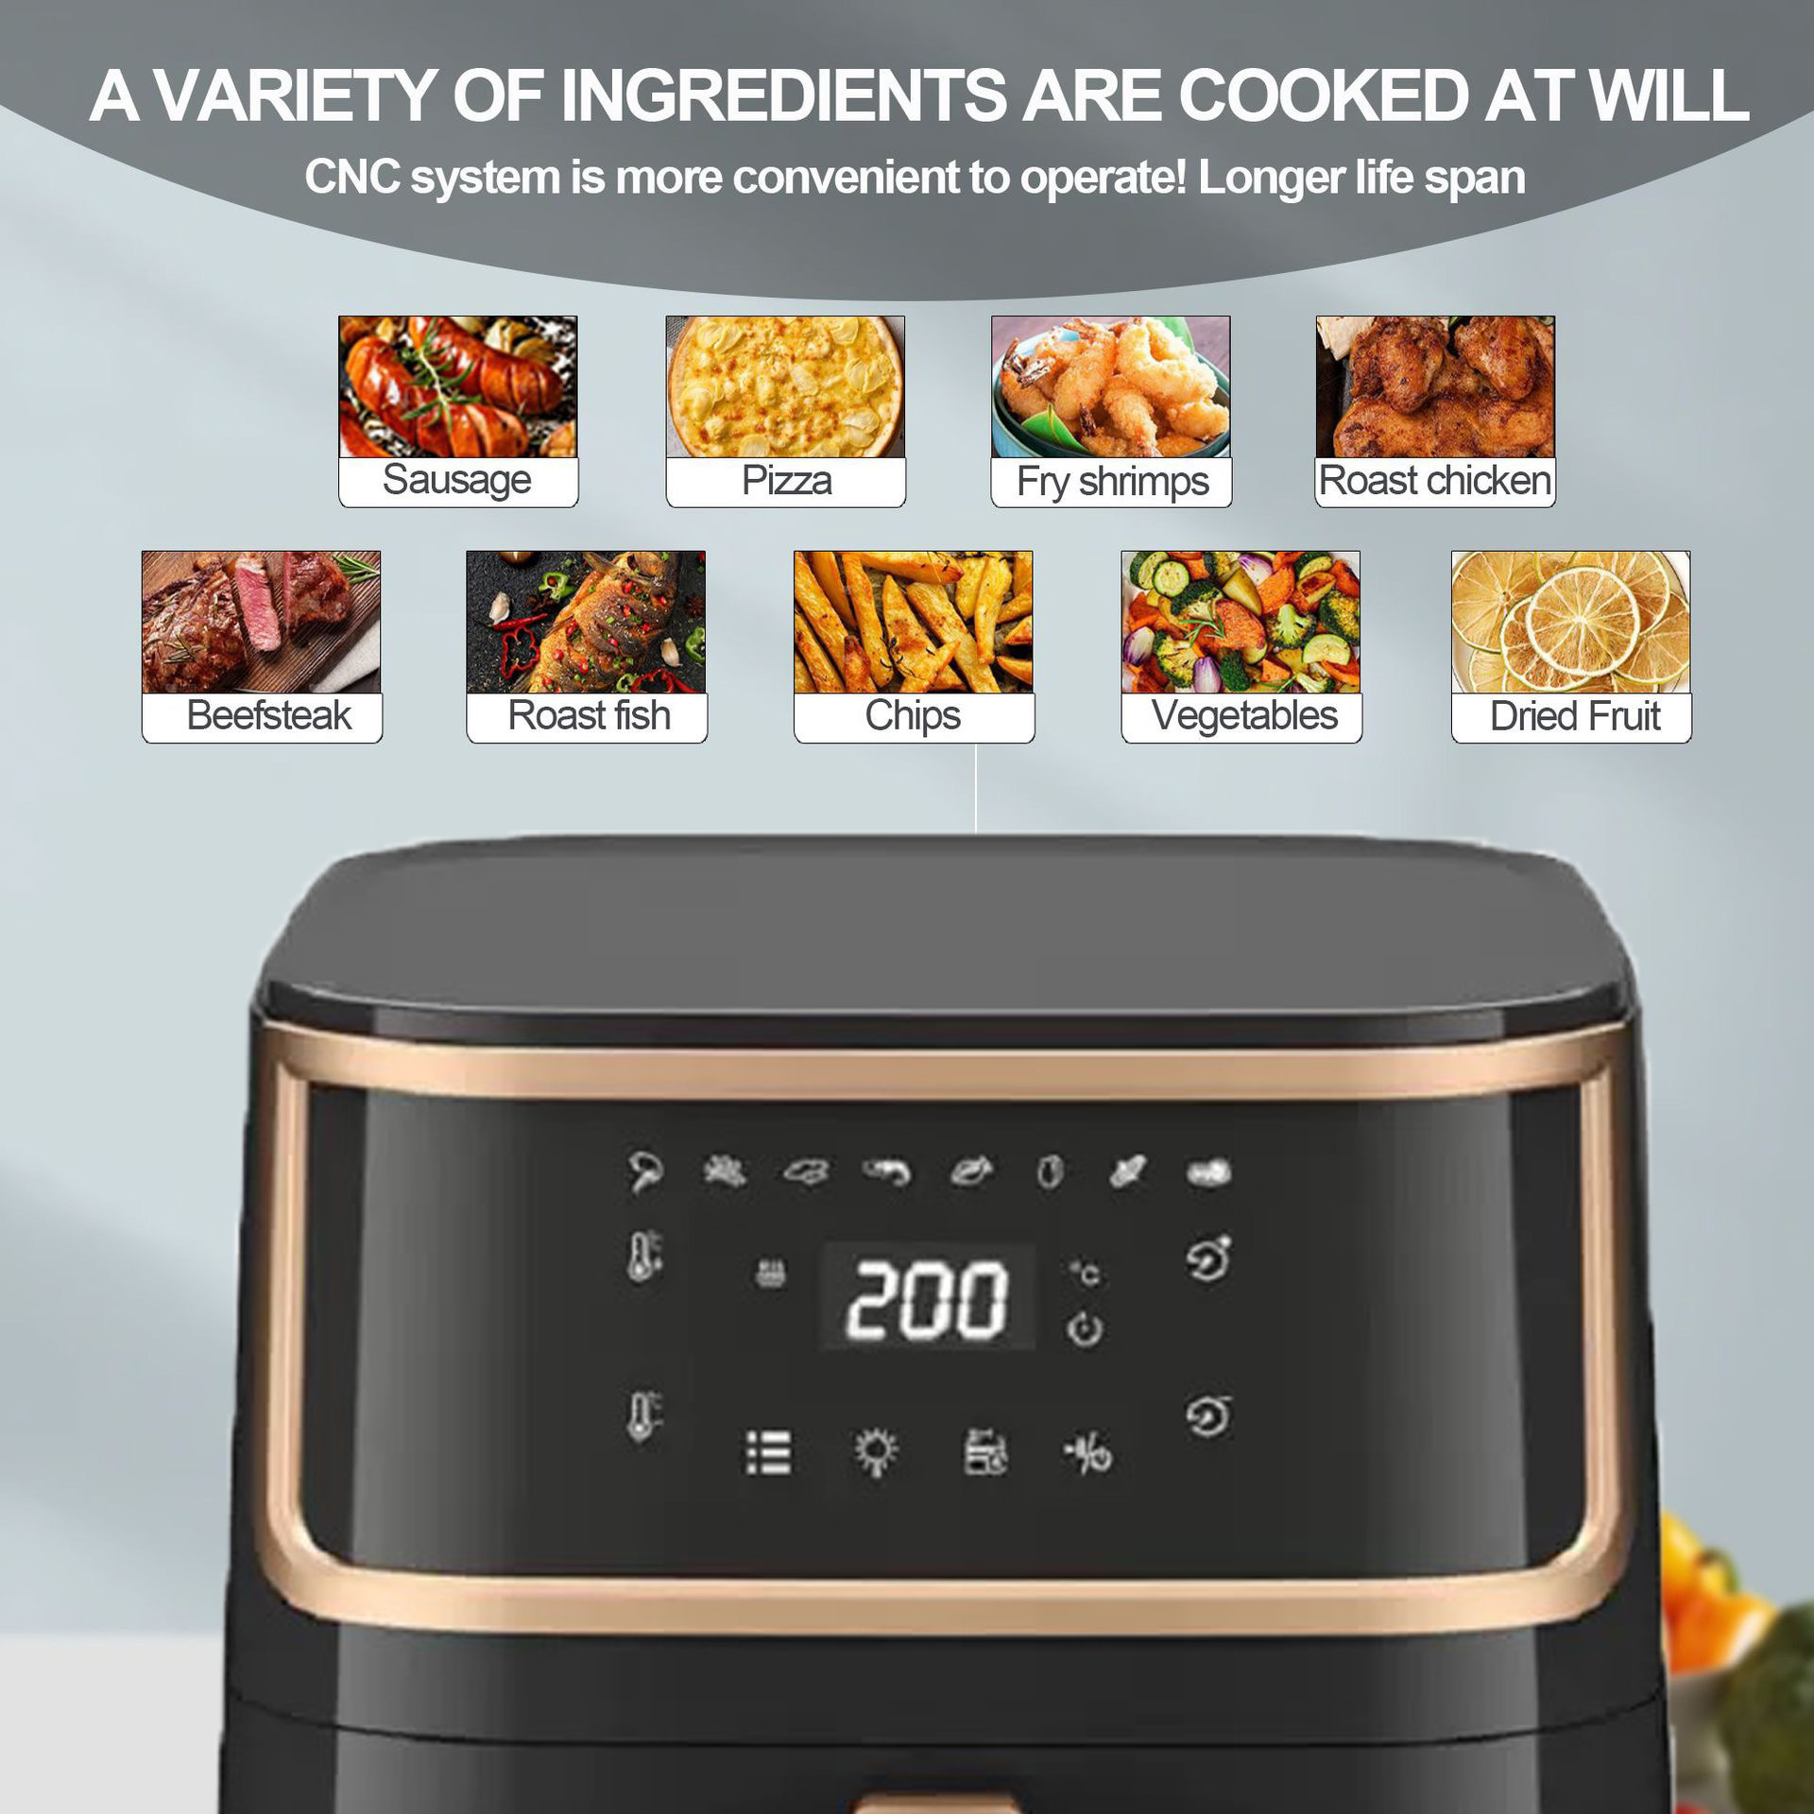
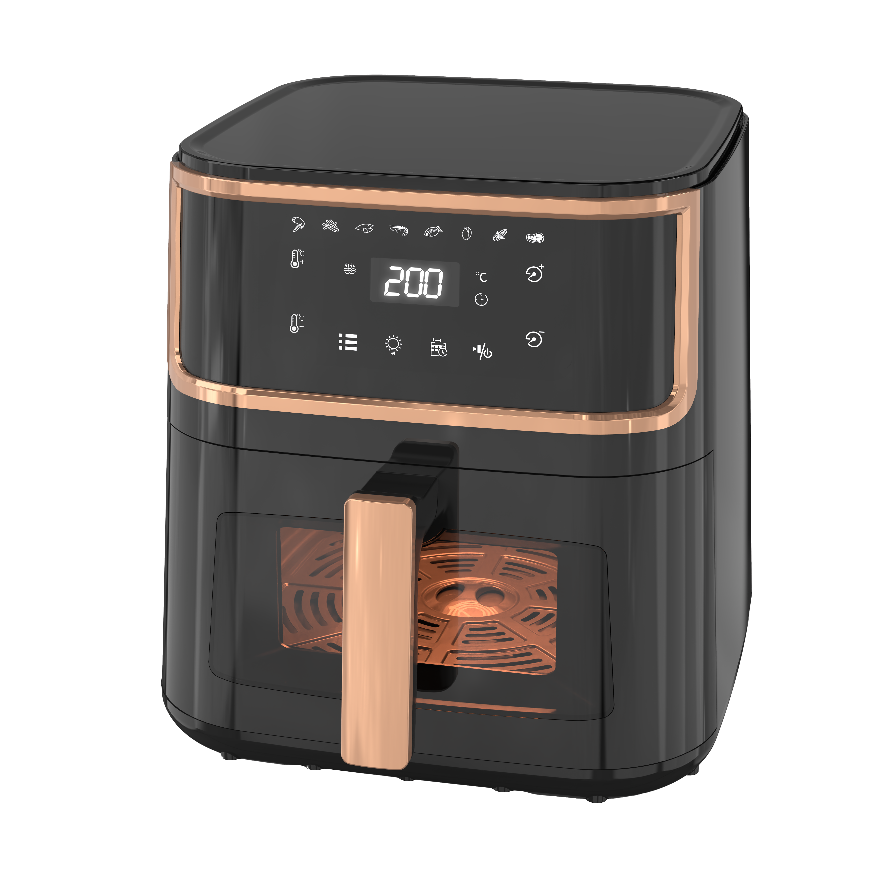
Air Fryer
AF-0808 8L AIR FRYER
·
Invisible Type
·
360° high - speed heating, 3D hot air circulation.
8L large capacity, meets family needs.
Colorful touchscreen, one - touch operation.
Pot - removal power - off protection, memory for continuous frying.
·
1700w
·
Rated power
35*35*37cm
Product Size
80~200℃
Temperature adjustment
Visible Type
8L
Capacity
1H
Set Time

Slide 17
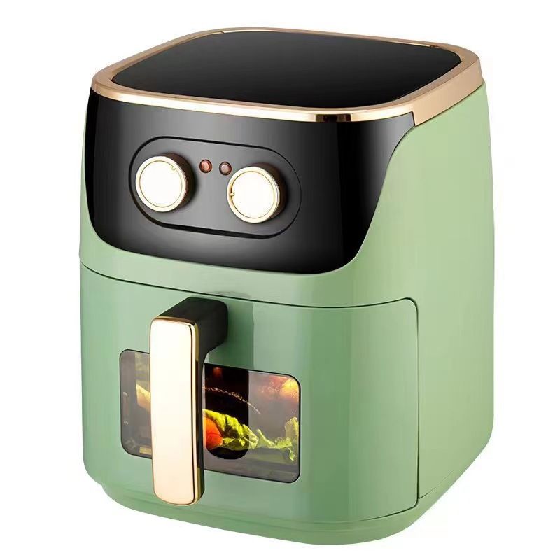
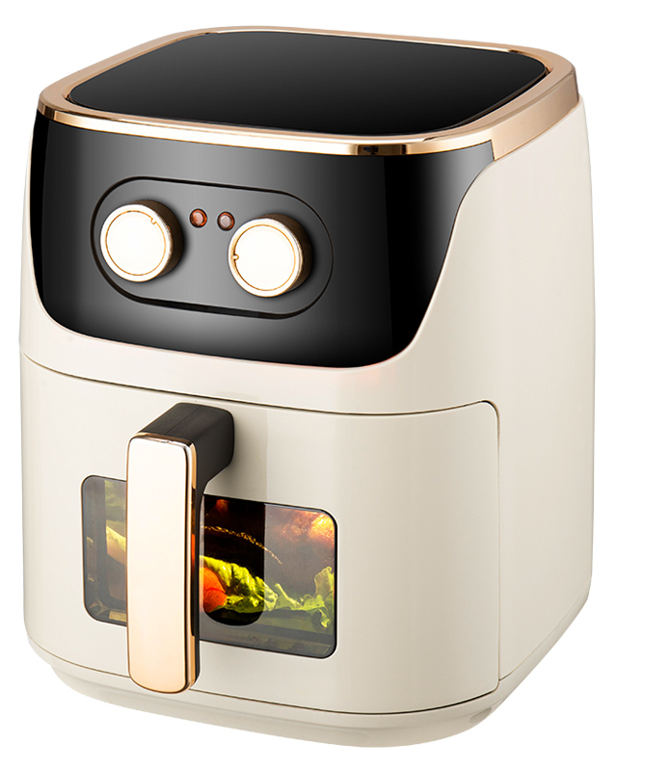
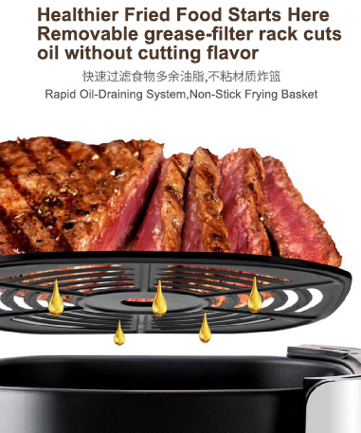
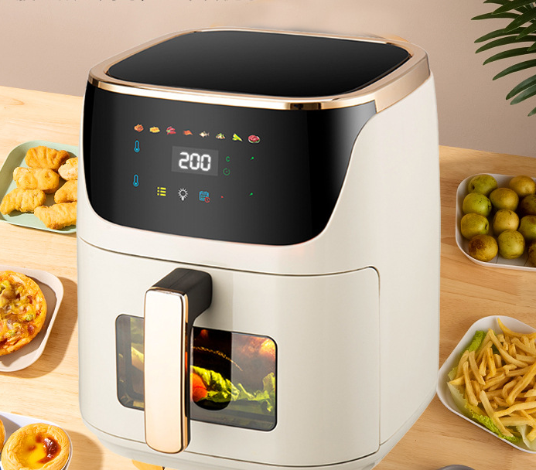
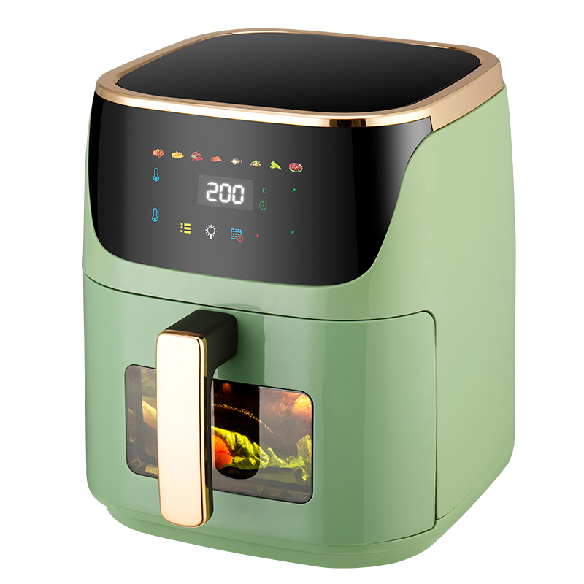
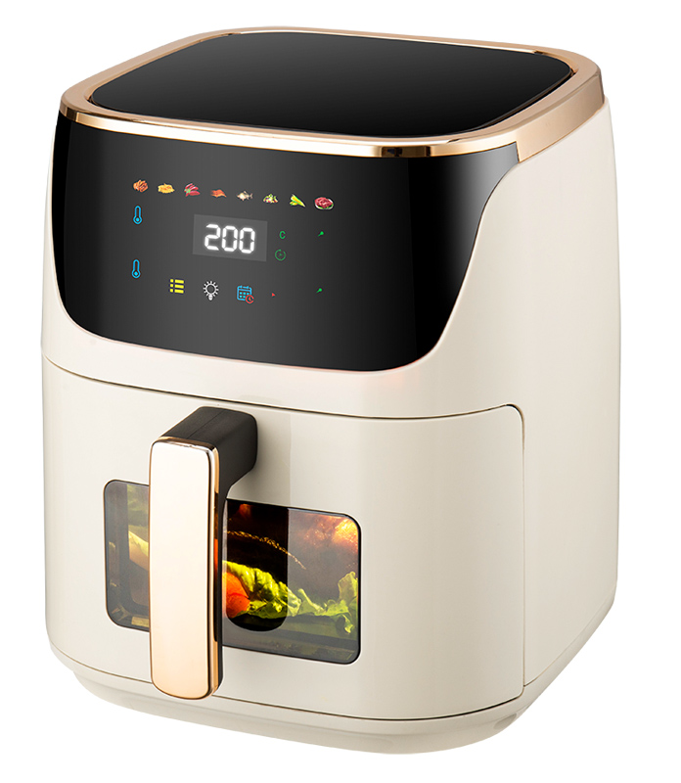
Air Fryer
AF-0701 7.5L AIR FRYER
·
·
360° high - speed heating, 3D hot air circulation.
7.5L capacity, meets family needs.
Colorful touchscreen buttons or dual rotary buttons, enjoy with a touch.
Visual window for food status check.
Pot - removal power - off protection, memory for continuous frying.
AF-0701M
Mechanical-style
·
1500w
·
Rated power
·
33*29*29cm
Product Size
7.5L
AF-0701D
Touchscreen version
Capacity
80~200℃
Temperature adjustment
1H
Set Time

Slide 18
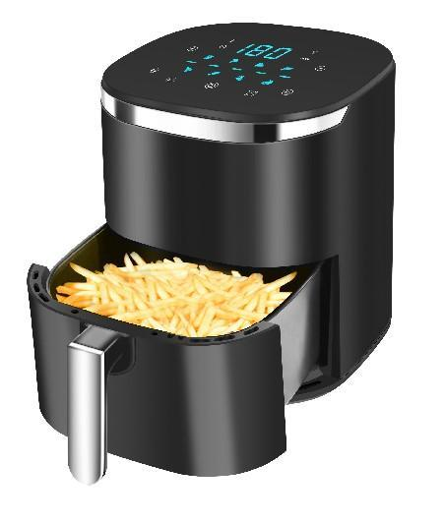
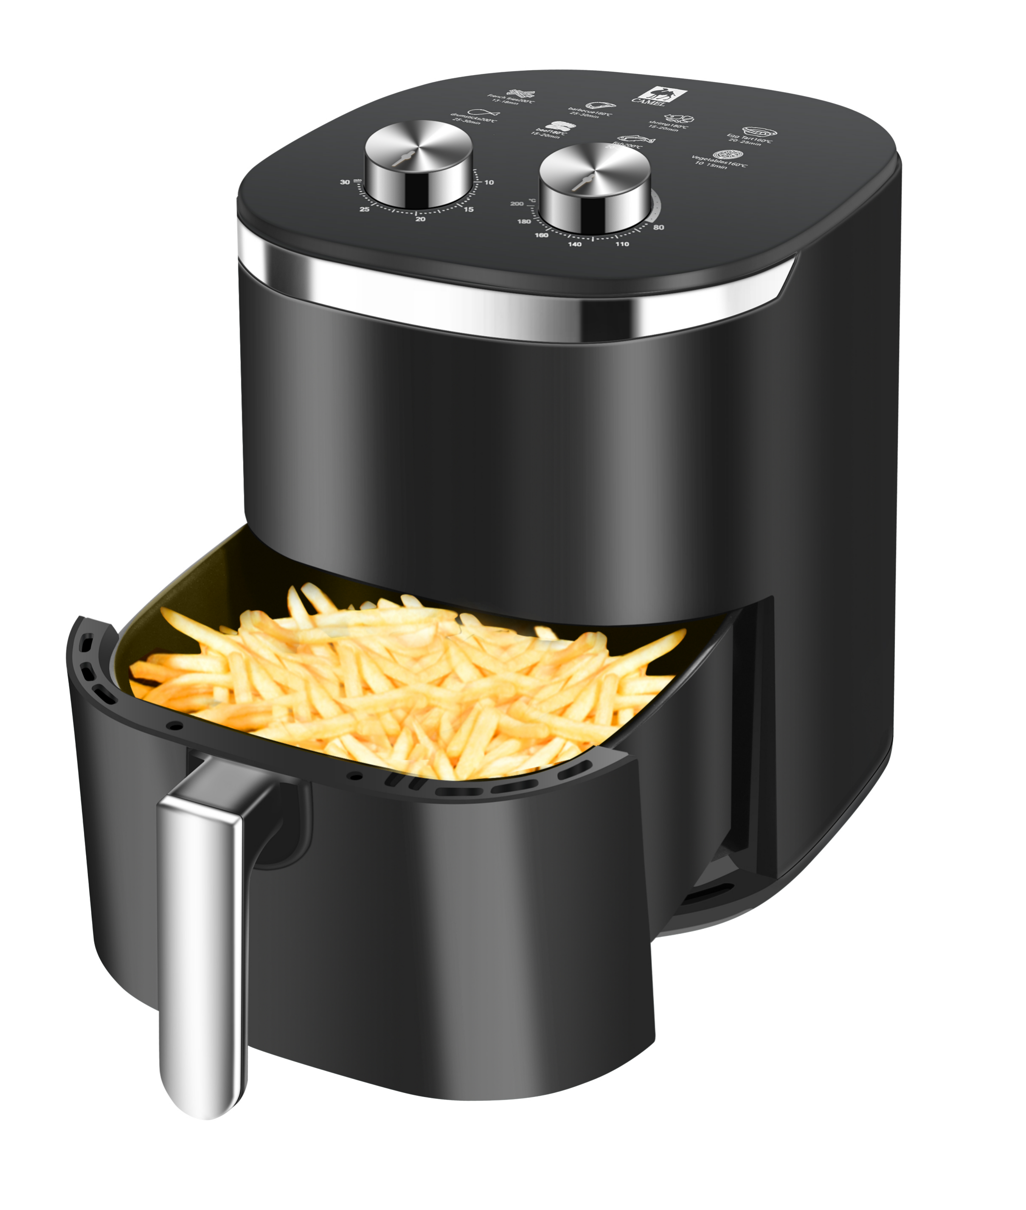


Air Fryer
AF-0601 6L AIR FRYER
·
·
360° high - speed heating, 3D hot air circulation.
7.5L capacity, meets family needs.
Colorful touchscreen buttons or dual rotary buttons, enjoy with a touch.
Visual window for food status check.
Pot - removal power - off protection, memory for continuous frying.
AF-0601
LCD Invisible Model
1400w
·
Rated power
·
·
38*33*30cm
Product Size
6L
Capacity
AF-0602
Mechanically Invisible Style
AF-0602
Mechanically Visible Style
AF-0601
LCD Visible Type
80~200℃
Temperature adjustment
1H
Set Time

Slide 19



Air Fryer
AF-0603 6L AIR FRYER
·
·
360° high - speed heating, 3D hot air circulation.
6L capacity, meets family needs.
Colorful touchscreen buttons or dual rotary buttons, enjoy with a touch.
Visual window for food status check.
Pot - removal power - off protection, memory for continuous frying.
1350w
·
Rated power
·
·
38*33*30cm
Product Size
6L
Capacity
LCD Type
Mechanical-style
80~200℃
Temperature adjustment
1H
Set Time

Slide 20



Air Fryer
AF-5501 5.5L AIR FRYER
·
·
360° high - speed heating, 3D hot air circulation.
5.5L capacity, meets family needs.
Colorful touchscreen buttons or dual rotary buttons, enjoy with a touch.
Visual window for food status check.
Pot - removal power - off protection, memory for continuous frying.
1500w
·
LCD Visible Model
Rated power
·
·
38*33*30cm
Product Size
5.5L
Capacity
80~200℃
Temperature adjustment
1H
Set Time

Slide 21



Air Fryer
AF-5502 5.5L AIR FRYER
·
·
360° high - speed heating, 3D hot air circulation.
7.5L capacity, meets family needs.
Colorful touchscreen buttons , enjoy with a touch.
Visual window for food status check.
Pot - removal power - off protection, memory for continuous frying.
1350w
·
Rated power
·
·
29.5*29.5*36.5cm
Product Size
5.5L
Capacity
80~200℃
Temperature adjustment
1H
Set Time

Slide 22





Air Fryer
AF-0502
LCD Visible Type
AF-0502
LCD Invisible Model
AF-0501 5L AIR FRYER
·
1500w
·
360° high - speed heating, 3D hot air circulation.
5L capacity, ideal for 2 - 3 people in small homes.
Intelligent dual knobs for time and temperature control, cook as you wish.
Pot - removal power - off protection, memory for continuous frying.
Rated power
·
·
30*25*30.5cm
Product Size
5L
AF-0501
Mechanically Invisible Style
AF-0501
Mechanically Visible Style
Capacity
80~200℃
Temperature adjustment
1H
Set Time

Slide 23






Air Fryer
AF-4501M 4.5L AIR FRYER
·
·
360° high - speed heating, 3D hot air circulation.
Openable round barrel. Easy clean, no hygiene blind spots.
Optional colorful touchscreen buttons or dual rotary buttons, enjoy with a touch.
8 preset menus make cooking a breeze.
Pot - removal power - off protection, memory for continuous frying.
1200w
·
Rated power
·
32*29*26cm
·
Product Size
80~200℃
Temperature adjustment
4.5L
Capacity
1H
Set Time
AF-4501M
Mechanical-style
AF-4501D
Touchscreen version

Slide 24



Air Fryer
AF-0401M 4L AIR FRYER
·
·
360° high - speed heating, 3D hot air circulation.
Round Tubular Drawer Type.Easy clean, no hygiene blind spots.
Optional colorful touchscreen buttons or dual rotary buttons, enjoy with a touch.
8 preset menus make cooking a breeze.
Pot - removal power - off protection, memory for continuous frying.
1200w
Rated power
·
·
29.5*29.5*36.5cm
·
Product Size
80~200℃
Temperature adjustment
4L
Capacity
1H
Set Time

Slide 25






Air Fryer
AF-0402 4L AIR FRYER
·
·
360° high - speed heating, 3D hot air circulation.
Round Tubular Drawer Type. Easy clean, no hygiene blind spots.
Optional colorful touchscreen buttons or dual rotary buttons, enjoy with a touch.
8 preset menus make cooking a breeze.
Pot - removal power - off protection, memory for continuous frying.
1200w
·
Rated power
·
29.7*29.7*32.2cm
·
Product Size
80~200℃
Temperature adjustment
4L
Capacity
1H
Set Time
AF-0402
Mechanical-style
AF-0403
Touchscreen version

Slide 26



Air Fryer
AF-3802 3.8L AIR FRYER
·
·
360° high - speed heating, 3D hot air circulation.
High Borosilicate Explosion-Proof Glass, Panoramic View
Colorful touchscreen, one - touch operation.
Pot - removal power - off protection, memory for continuous frying.
·
·
1200w
80~200℃
Rated power
Temperature adjustment
31.7*31.7*33cm
1H
Product Size
Set Time
3.8L
Capacity

Slide 27



Air Fryer
AF-3802 3.8L AIR FRYER
·
·
360° high - speed heating, 3D hot air circulation.
3L capacity, ideal for 2 - 3 people in small homes.
Intelligent dual knobs for time and temperature control, cook as you wish.
Pot - removal power - off protection, memory for continuous frying.
·
·
1200w
80~200℃
Rated power
Temperature adjustment
31*23*22.5cm
1H
Product Size
Set Time
3L
Capacity

Slide 28


Zhejiang Xunmai Electronics Co., Ltd.
Address: Building 1, Huadong Digital Economy Industrial Park, Qujiang District, Quzhou City, Zhejiang Province
Telephone: +(0570) 828 0566
+86-18657091666
Email: jack@cnxunmai.com

